Slide 1
Selenium WebDriver
Test Automation Lectures

Slide 2
Manual Testing vs Automation Testing
Manual testing is executed manually while automation testing is done using an automation tool .
There are different types of automation tools in the market today which are commonly used by different companies as per their need and preference.
Like
Selenium
Cypress,
UTF etc
Test Automation:
Automated testing is a software testing technique that automates the process of validating the functionality of software and ensures it meets requirements before being released into production. With automated testing, an organization can run specific software tests at a lot faster pace than manual testers. Automated testing is best suited for large or repetitive test cases.

Slide 3
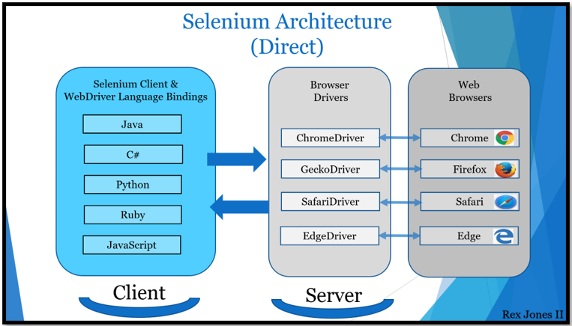
Selenium automation tool
Selenium is an open source (free) automated testing suite to test web applications. It supports different platforms, browsers and language bindings: .
Operation System Support – Windows, Mac OS, Linux, Solaris.
Browser Support – Mozilla Firefox, Internet Explorer, Google Chrome 12.0. 712.0 and above, Safari, Opera 11.5 and above, Android, iOS, HtmlUnit 2.9 and above.
Language Bindings - C#, Java, JavaScript, Ruby, and Python
Selenium automates browsers. That’s it! what you can do with that power is entirely up to you!
What is selenium ?

Slide 4
Selenium Components:
Selenium WebDriver
Selenium IDE
Selenium Grid
Selenium WebDriver(WebDriver drives a browser)
Selenium WebDriver is a browser automation framework that accepts commands and sends them to a browser. It is implemented through a browser-specific driver. It controls the browser by directly communicating with it.
Selenium IDE: A Firefox/chrome extension to record and play the user actions performed on a web page.
Selenium Grid: What is Selenium grid vs WebDriver?
Selenium WebDriver is an API that executes our test by driving a browser for automating an Application Under Test (AUT) while Selenium Grid executes our test across multiple browsers, operating systems, and machines.

Slide 5
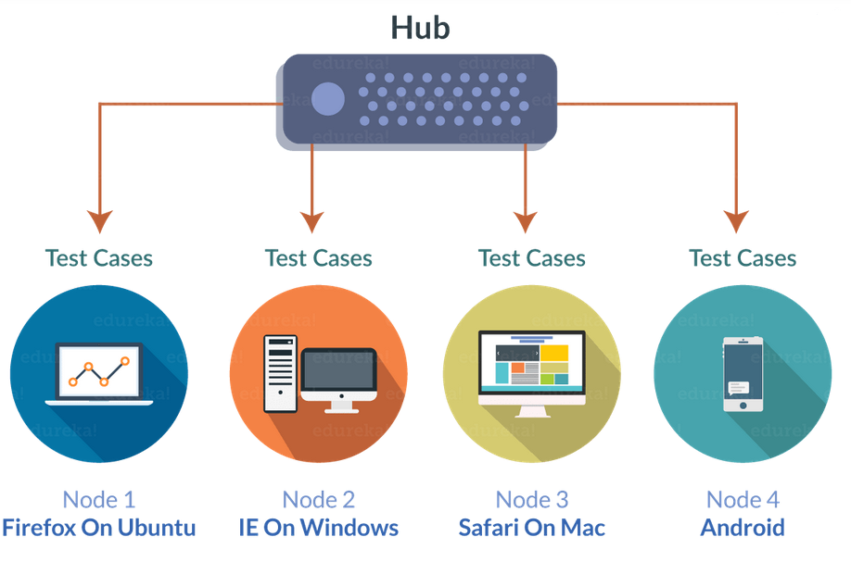
Selenium IDE
Selenium IDE (Selenium Integrated Development Environment):
It is the simplest framework in the Selenium Suite. It allows us to record and playback the scripts
It is a Chrome, Firefox and Edge add-on that will do simple record-and-playback of interactions with the browser.
Selenium Grid
Selenium Grid can be used to execute same or different test scripts on multiple platforms and browsers concurrently so as to achieve distributed test execution.
Advantages of Selenium Grid?
• It allows running test cases in parallel thereby saving test execution time.
• It allows multi-browser testing
• It allows us to execute test cases on multi-platform

Slide 6
Advantages of Selenium Automation Tool
• Free and open source
• Have large user base and helping communities
• Cross-browser compatibility
• Platform compatibility
limitations of Selenium WebDriver
• We cannot test windows application
• We cannot test mobile apps
• Limited reporting
• Handling dynamic Elements
• Handling page load
• Handling pop up windows
• Handling captcha

Slide 7
Work with Selenium WebDriver interface
To start writing selenium code, take the following steps:
Create a maven project
Import the required dependencies for your maven project
Import WebDriverManager
Initialize WebDriver interface
And use the WebDriver implementing classes
WebDriverManager.chromedriver(). setup ();
WebDriver driver = new ChromeDriver();
1)Maven is an automation and management tool developed by Apache Software Foundation.
It allows developers to create projects, dependency, and documentation using Project Object Model and plugins.
2)WebDriverManager is an open-source Java library that carries out the management (i.e., download, setup, and maintenance) of the drivers required by Selenium WebDriver (e.g., chromedriver, geckodriver, msedgedriver, etc.) in a fully automated manner
3) WebDriver interface: Selenium supports automation of all the major browsers in the market through the use of WebDriver.
WebDriver is an interface and implemented by its implementing classes like (ChromeDrive, EdgeDriver, InternetExplorerDriver, SafariDriver, RemoteWebDriver, ChromiumDriver ) and its superinterface is SearchContext.

Slide 8
WebDriverManager provides a set of managers for Chrome, Firefox, Edge, Opera, Chromium, and Internet Explorer.
The basic use of these managers is the following:
WebDriverManager.chromedriver().setup();
WebDriverManager.firefoxdriver().setup();
WebDriverManager.edgedriver().setup();
WebDriverManager.operadriver().setup();
WebDriverManager.chromiumdriver().setup()
WebDriverManager.iedriver().setup();
Interface WebDriver’s implementing classes:
ChromeDriver driver = new ChromeDriver();
FirefoxDriver driver = new FirefoxDriver();
InternetExplorerDriver driver = new InternetExplorerDriver();
InternetExplorerDriver driver = new InternetExplorerDriver();
EdgeDriver driver = new EdgeDriver();
etc

Slide 9
Using SetProperty in Selenium:
The other way to run our selenium code, we need to use System.setpropert.
Steps to take :
1) Install a Selenium library
Setting up the Selenium library for your favorite programming language.
https://www.selenium.dev/downloads/
Import the selenium library for your java language installed in your machine
Import those libraries or jar files into your project build path
2) Install browser drivers
Download the browser drivers into your machine
https://www.selenium.dev/documentation/webdriver/getting_started/install_drivers/
3) Setting up your system to allow a browser to be automated.
System.setProperty("webdriver.chrome.driver"," C:/browsersDrivers/chromedriver.exe");
System.setProperty("webdriver.chrome.driver", "C:\\browsersDrivers\\ChromeDriver\\chromedriver.exe");
System.setProperty("webdriver.chrome.driver", "C://browsersDrivers//chromedriver.exe");
4) Initialize WebDriver Interface
WebDriver driver = new ChromeDriver();
5) $) Write your first Selenium script
driver.get("https://corammerswork.ml/wordpress/test1/");
String Title = driver.getTitle();
System.out.println(Title);

Slide 10
Interface WebDriver Commands used to for browser automation:
//Browser navigation
driver.get("https://selenium.dev");
//Longer way
driver.navigate().to("https://selenium.dev");
driver.navigate().forward();
driver.navigate().back();
//Refresh the current page
driver.navigate().refresh();
Driver.quit();
driver.close();
driver.get("https://www.google.com/");
driver.manage().window().fullscreen();
Driver.manage().window().maximize();
Driver.manage.().window().minimize();
driver.manage().timeouts().pageLoadTimeout(Duration.ofSeconds(20));
driver.manage().timeouts().implicitlyWait(Duration.ofSeconds(10));
//Get browser info
driver.getTitle();
driver.getCurrentUrl();

Slide 11
How To Find Elements in Selenium WebDriver?
HTML or web elements play a major role while testing an application. The first thing to do is to locate these elements on the web page.
In order to find an element or elements of a web page we need to use the following two methods of WebElement interface :
FindElement ();
FindElements();
And use locators to locate these element on the page.
Locators
There are eight different common locators to uniquely identify an HTML element on a web page. We can find the location of an element by the following methods:
by.id()
by.name()
by.ClassName()
by.TagName()
by.LinkText()
by.PartialLinkText()
by.Xpath()
by.CSS Selector()

Slide 12
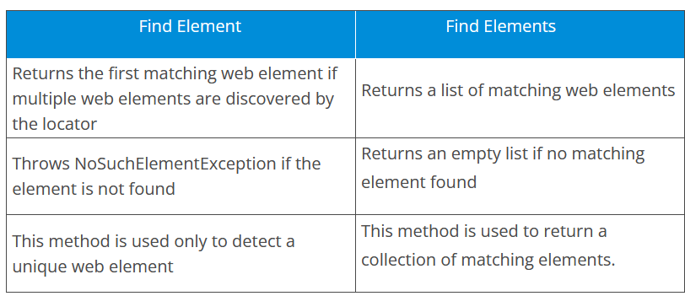
Terminologies:
Inspect
DOM(Document Object Model)
Tag
Attribute
Value
HTML element
Developer tools
Note:
Web Elements on a web page may not have all the attributes declared
It is up to the developer of the test script to select the attribute that uniquely identifies the Web Element on the web page for the automation.

Slide 13
Locators Examples:
The By.id() method
<input id="search" type="search" name="q" value="" class="input-text required-entry" maxlength="128" placeholder="Search entire store here..." autocomplete="off">
WebElement searchBox = driver.findElement(By.id("search")); searchBox.sendKeys("Bags"); searchBox.submit();
The By.name() method
<input id="search" type="search" name="q" value="" class="input-text required-entry" maxlength="128" placeholder="Search entire store here..." autocomplete="off">
WebElement searchBox = driver.findElement(By.name("q")); searchBox.sendKeys("Phones"); searchBox.submit();

Slide 14
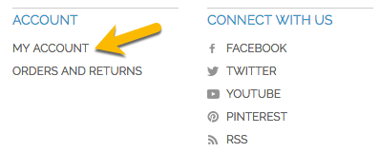
The By.className() method
<button name="sampleBtnName" id="sampleBtnId" class="button">I'm Button</button>
Sometimes, an element might have multiple values given for the class attribute. For example, the Search button has button and search-button values specified in the class attribute in the following HTML snippet:
<button type="submit" title="Search" class="button search-button"><span><span>Search</span></span></button>Copy
We have to use one of the values of the class attribute with the By.className method. In this case, we can either use button or search-button, whichever uniquely identifies the element.
The By.linkText() method
As the name suggests, the By.linkText locating mechanism can only be used to identify the HTML links
The HTML link elements are represented on a web page using the <a> tag, an abbreviation for the anchor tag.
A typical anchor tag looks like this:
<a href="http://demo-store.seleniumacademy.com/customer/account/" title="My Account">My Account</a>
Here, href is the link to a different page where your web browser will take you when you click on the link. So, the preceding HTML code when rendered by the browser looks like this:
WebElement myAccountLink = driver.findElement(By.linkText("MY ACCOUNT")); myAccountLink.click();

Slide 15
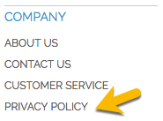
The By.partialLinkText() method
The By.partialLinkText locating mechanism is an extension of the By.linkText locator. If you are not sure of the entire link text or want to use only part of the link text, you can use this locator to identify the link element
WebElement orderAndReturns = driver.findElement(By.partialLinkText("PRIVACY")); orderAndReturns.click();
The linkText and partialLinkText methods are case-sensitive.
What happens if there are multiple links whose text has Privacy in it? That is a question for the findElement() method rather than the locator. Remember when we discussed the findElement() method earlier, it will return only the first WebElement that it comes across. If you want all the WebElements that contain Privacy in its link text, use the findElements() method, which will return a list of all those elements.

Slide 16
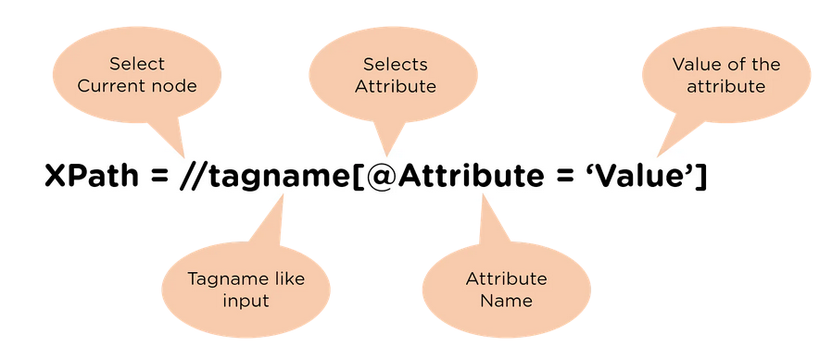
What is Xpath:
XPath is used to locate the elements.
XPath can be used to navigate through elements and attributes in an XML document.
XPath stands for XML Path Language
XPath uses "path like" syntax to identify and navigate nodes in an XML document
In our test automation codes, we generally prefer to use id, name, class, etc. these kinds of locators.
However, sometimes we can not find any of them in the DOM(Document Object Model) and also sometimes locators of some elements change dynamically in the DOM. In these kinds of situations, we need to use xpath locators.
These locators must be capable to locate complex and dynamically changing web elements.
Reference: https://www.w3schools.com/xml/xpath_intro.asp
How to create xpath ?
Absolute Path & Relative Path
• Absolute XPath starts from the root node and ends with desired descendant element’s node.
It starts with top HTML node and ends with input node.
It starts with a single forward slash(/) as shown below
/html/body/div[3]/div[1]/form/table/tbody/tr[1]/td/input
• Relative XPath starts from any node in between the HTML page to the current element’s node(last node of the element).
It starts with a double forward slash(//) as shown below.
//input[@id='email']
//tag[@attribute='value']

Slide 17
Types of Xpath:
1. Basic XPath
XPath expression selects nodes or lists of nodes on the basis of attributes like ID, name, class name, etc. from the XML document as illustrated below.
XPath=//tagName[@attribute=‘value’]
2. Contains()
Contains() is a method used in an XPath expression. It is used when the value of any attribute changes dynamically —
for example :
XPath=//*[contains(@attribute,’Value’)
3. Using OR & AND
In an OR expression, two conditions are used, whether the first condition OR second condition should be true. It is also applicable if any one condition is true, or maybe both. This means that any one condition should be true to find the element.
In the following XPath expression, it identifies the elements whose single or both conditions are true.
XPath=//*[@id='FirstName' or @name='LastName’]
In the AND expression, two conditions are used. Both conditions should be true to find the element. It fails to find the element if any one condition is false.
XPath=//*[@id='FirstName' and @name='FirstName’]

Slide 18
4. The Starts-With Function
The Starts-With function finds the element whose attribute value changes on refresh or any operation on the webpage. In this expression, match the starting text of the attribute used to find the element whose attribute changes dynamically. You can also find the element whose attribute value is static (does not change).
For example, suppose the ID of a particular element changes dynamically like:
Id=" message12"
Id=" message345"
Id=" message8769"
And so on. But the initial text is the same. In this case, we use the Start-With expression “message.”
XPath=//input[starts-with(@class,'form’)]
5. Text()
In this expression, with the text function, we find the element with the exact text match as shown below. In this case, we find the element with the text "Username or email."
XPath=//*[text()='Username or email']
6. Using Index:
This approach comes in use when you wish to specify a given tag name in terms of the index value you wish to locate.
XPath=(//*[@attribute='value'])[index]

Slide 19
XPath Axes An axis represents a relationship to the context (current) node, and is used to locate nodes relative to that node on the tree.

Slide 20
Xpath Axes and Relationship of Nodes:

Slide 21
Selenium 4 relative locators
Above();
Below();
toLeftOf();
toRightOf();
Near();
Examples:
https://www.selenium.dev/documentation/webdriver/elements/locators/

Slide 22
What are CSS Selectors in Selenium?
CSS Selectors are one of the locator strategies offered by Selenium to identify the web elements
To validate your xpath or cssSelector:
Console button:
$x( “ your xpath” ) Enter
$(“ your cssSelect” ) Enter
How to create a CSS Selector?
CSS Selector syntax is quite similar to the XPath syntax. It can be represented syntactically as follows:
node[attribute_name = ‘attribute_value’]
node[attribute_name = ‘attribute_value’]
How to create a CSS Selector using ID attribute?
tagName[attribute =‘value’] or just tagName#value
How to create a CSS Selector using class attribute?
tagName[attribute=‘value’] or just tagName.value
Examples:
And so on …

Slide 23
The By.tagName() method
Locating an element by tag name is slightly different from the locating mechanisms we saw earlier. For example, on a Homepage,
if you search for an element with the button tag name, it will result in multiple WebElements because there are nine buttons present on the Homepage. So, it is always advisable to use the findElements() method rather than the findElement() method when trying to locate elements using tag names.
Examples for Practice:
driver.get("https://www.sugarcrm.com/au/request-demo");
// get all links from the Home page
List<WebElement> links = driver.findElements(By.tagName("a")); System.out.println("Found links:" + links.size());
//List<WebElement>allLinks = driver.findElements(By.tagName("option"));
//List<WebElement>allLinks = driver.findElements(By.tagName("a"));
List<WebElement>allLinks = driver.findElements(By.tagName("script"));
System.out.println(allLinks.size());
for(int i=0; i<allLinks.size(); i++)
//System.out.println(allLinks.get(i).getAttribute("href"));
System.out.println(allLinks.get(i).getAttribute("type"));
//System.out.println(allLinks.get(i).getText());

Slide 24
What is Actions Class in Selenium?
Actions class is a collection of individual Action that you want to perform. For e.g. we may want to perform a mouse click on an element. In this case we are looking at two different Actions
Moving the mouse pointer to the element
Clicking on the element
Collection of such Action is represented by the Actions class.
Fore more →https://www.selenium.dev/selenium/docs/api/java/org/openqa/selenium/interactions/Actions.html
Actions Class methods are like:
doubleClick(): Performs double click on the element
clickAndHold(): Performs long click on the mouse without releasing it
dragAndDrop(webelement source): Drags the element from one point and drops to another
moveToElement(): Shifts the mouse pointer to the center of the element
contextClick(): Performs right-click on the mouse
Click():Clicks at the current mouse location.
Click( WebElement ele)
Release (WebElement ele)
ScrollToElement (WebElement ele)
And many more…

Slide 25
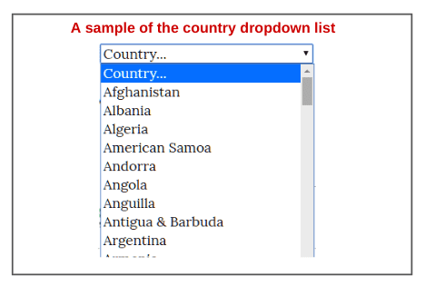
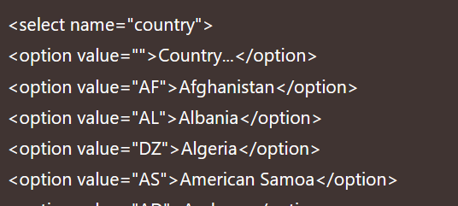
Select Class in Selenium | Select Class Methods
Select is a class provided by Selenium that is used to work with static dropdown elements.
The select class allows us to select an element from the drop-down and lists that are created with the HTML <select> element.
Select Class Models a SELECT tag, providing helper methods to select and deselect options.
An HTML <select> tag provides methods and properties for selecting and deselecting options in a dropdown.
Here, we have shown the country dropdown list for demo purposes in the below screenshot. This kind of country list is generally seen in the registration form of a web application.
Fore more: https://www.selenium.dev/selenium/docs/api/java/org/openqa/selenium/support/ui/Select.html
selectByValue();
selectByVisibleText();
selextByIndex()
deselectByVisibleText();
deselectByIndex
deselectByValue
deselectAll()
getAllSelectedOptions();
getFirstSelectedOptions();

Slide 26
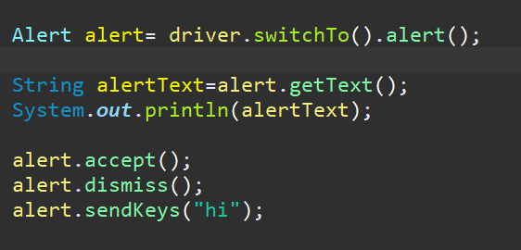
Interface Alert
Alert in Selenium is a message/notification box that notifies the user about some information or asks for permission to perform a certain kind of operation. It may be used for warning purposes as well.
Alert has the following methods:
.getText() – Gets the text of an alert
.sendKeys(String) – Send string to the alert
.accept() – Clicks the “Ok” button of the alert
.dismiss() – Clicks the “Cancel” button of the alert

Slide 27
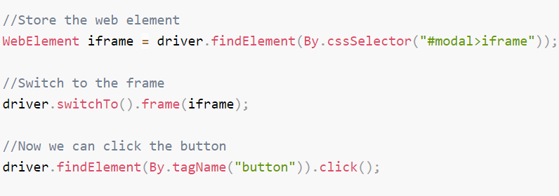
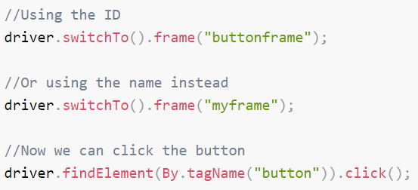
Working with IFrames and frames
Frames are a now deprecated means of building a site layout from multiple documents on the same domain. You are unlikely to work with them unless you are working with a pre HTML5 webapp. Iframes allow the insertion of a document from an entirely different domain and are still commonly used.
WebDriver offers three ways of switching to a frame.
Using a WebElement
Using a name or ID
If your frame or iframe has an id or name attribute, this can be used instead. If the name or ID is not unique on the page, then the first one found will be switched to.
Using an index
It is also possible to use the index of the frame, such as can be queried using window.frames in JavaScript.

Slide 28
Javascript Executor in Selenium
What is JavaScriptExecutor in Selenium?
JavaScriptExecutor is an interface that is used to execute JavaScriprt through selenium webdriver.
JavaScript is a programming language that interacts with HTML in a browser, and to use this function in Selenium, JavascriptExecutor is required.
JavaScript Executor can be used when webdriver fails to click or select any Element. It will enable the Webdriver to directly interact with the HTML elements.
Java script can also be used when the Element is not Interactable
Why we use JavaScriptExecutor?
There are locators in Selenium WebDriver like ID, Class, XPath, etc., to work with elements on a web page.
Sometimes these default Selenium locators may not work. Here comes the JavaScriptExecutor in the picture.
JavaScriptExecutor is used to perform operations on a web page.
JavascriptExecutor in Selenium enables the WebDriver to interact with HTML DOM within the browser
JavascriptExecutor Provides Methods like:
ExecuteScript
ExecuteAsyncScript

Slide 29
How to Apply JavaScriptExecutor
1. Import the package
Import org.openqa.selenium.JavascriptExecutor;
2. Create a reference
JavascriptExecutor js = (JavascriptExecutor) driver;
3. Call the JavascriptExecutor method
js.executeScript(script, args);
Examples of JavascriptExecutor in Selenium
Example 1. JavascriptExecutor in Selenium to refresh the browser window
JavascriptExecutor js = (JavascriptExecutor) driver;
js.executeScript(“location.reload()”);
Example 2. JavascriptExecutor in Selenium to send text
JavascriptExecutor js = (JavascriptExecutor) driver;
js.executeScript(“document.getElementByID(‘element id ’).value = ‘xyz’;”);
Example 3. Get Title of a WebPage
JavascriptExecutor js = (JavascriptExecutor)driver;
string sText = js.executeScript(“return document.title;”).toString();
Example 4. Scroll Page
JavascriptExecutor js = (JavascriptExecutor)driver;
//Vertical scroll – down by 150 pixels
js.executeScript(“window.scrollBy(0,150)”);
Example 5. Click an Element
JavascriptExecutor js = (JavascriptExecutor)driver;
js.executeScript("arguments[0].click();", java);
Example 5. click an element

Slide 30
1.Scrol to an element:
JavascriptExecutor js = ((JavascriptExecutor)driver);
js.executeScript("arguments[0].scrollIntoView(true);",element);
2. Click an element:
JavascriptExecutor js = ((JavascriptExecutor)driver);
js.executeAsyncScript("arguments[0].click", element);
3. Sendkkeys:
JavascriptExecutor js = ((JavascriptExecutor) driver);
js.executeScript("document.getElementById('" + element + "').value='" + value + “’”);
4.SelectCalenderDate:
JavascriptExecutor js = ((JavascriptExecutor) driver);
js.executeScript("arguments[0].setAttribute('value','" + date + "');", element);
5.Get title of the page:
String script = " return document.title;";
String title = (String) js.executeScript(script);
System.out.println(title);

Slide 31
How to handle multiple windows/tabs in Selenium?
WebDriver does not make the distinction between windows and tabs. If your site opens a new tab or window, Selenium will let you work with it using a window handle. Each window has a unique identifier which remains persistent in a single session. You can get the window handle of the current window by using:
Driver.getwindowhandle();
What is a window in Selenium?
A window in any browser is the main webpage on which the user is landed after hitting a link/URL. Such a window in Selenium is referred to as the parent window also known as the main window which opens when the Selenium WebDriver session is created and has all the focus of the WebDriver.
It involves Parent window and a child window or multiple child windows in a parent window.
What is a window handle in Selenium?
A window handle stores the unique address of the browser windows. It is just a pointer to a window, whose return type is alphanumeric. The window handle in Selenium helps in handling multiple windows and child windows. Each browser will have a unique window handle value with which we can uniquely identify it.

Slide 32
Switching windows or tabs
Clicking a link which opens in a new window will focus the new window or tab on screen, but WebDriver will not know which window the Operating System considers active. To work with the new window you will need to switch to it. If you have only two tabs or windows open, and you know which window you start with, by the process of elimination you can loop over both windows or tabs that WebDriver can see, and switch to the one which is not the original.
However, Selenium 4 provides a new api NewWindow which creates a new tab (or) new window and automatically switches to it.
What are the different methods used for window handling in Selenium?
Selenium WebDriver provides various methods for handling of windows. Few of them are:
getWindowHandle( ): When a website opens, we need to handle the main window i.e the parent window using driver.getWindowHandle( ); method. With this method, we get a unique ID of the current window which will identify it within this driver instance. This method will return the value of the String type.
getWindowHandles( ): To handle all opened windows which are the child windows by web driver, we use driver.getWindowHandles( ); method. The windows store in a Set of String type and here we can see the transition from one window to another window in a web application. Its return type is Set <String>.
switchto(): Using this method we perform switch operation within windows.
And also we use Iterator interface to iterator through multiple windows.

Slide 33
What is Wait in Selenium?
&
How to resolve Synchronization issues in Selenium
Selenium Wait is just a set of commands that wait for a specified period of time before executing test scripts on the elements.
When to wait and how long to wait depends on the written script and type of wait used. You may be waiting for an element to load or become visible, or you may want to wait till the complete page loads.
Types of Selenium Waits
1-Implicit wait
2-Explicit wait
3-FluentWait
Three of these sections have their own relevance and use cases under which they are preferred by a tester in automation testing.

Slide 34
Implicit wait in Selenium
An implicit wait is a global wait, it is applied to all the web elements on the web page.
This means that we can tell Selenium that we would like it to wait for a certain amount of time before throwing an exception that it cannot find the element on the page or the page is not loaded or the javascript execution is not finished.
Also, important to note that once set, Implicit Wait stays in place for the entire duration for which the browser is open.
We can apply implicit wait through Interface WebDriver.Timeouts methods:
implicitlyWait()
pageLoadTimeout()
ImplicitlyWait(): Specifies the amount of time the driver should wait when searching for an element if it is not immediately present.
PageLoadTimeout(): specifies the amount of time that the driver should waif for the page to load.

Slide 35
Explicit Wait in Selenium
Explicit Wait: This wait is used to allow your code to halt program execution, or freeze the thread, until the condition you pass it resolves.
The condition is called with a certain frequency until the timeout of the wait is elapsed. This means that for as long as the condition returns a false value, it will keep trying and waiting.
Since explicit waits allow you to wait for a condition to occur, they make a good fit for synchronising the state between the browser and its DOM, and your WebDriver script.
We use WebDriverWait class in selenium for using explicit waits.

Slide 36
Fluent wait in Selenium
The fluent wait is similar to explicit wait in Selenium with one additional argument of frequency (also known as polling time).
The frequency number tells the WebDriver to keep checking for the element at regular intervals and wait till the maximum of "Duration.ofSeconds".
This saves execution time. If the element becomes available earlier, we can proceed with our execution and finish quickly.
FluentWait in Selenium is an important class when we are dealing with AJAX elements. When a user is exploring the website on a slower network, these elements may take more time to load than what they would have taken in lab testing. To play safe, FluentWait helps us mimic such scenarios and produce the best quality web application.

Slide 37
Common Exceptions in Selenium
InvalidArgumentException() | The arguments passed to a command are either invalid or malformed.
ElementNotInteractableException() | Thrown when an element is present in the DOM but interactions with that element will hit another element due to paint order.
ElementNotSelectableException() | Thrown when trying to select an unselectable element.
ElementNotVisibleException() | Thrown when an element is present on the DOM, but it is not visible, and so is not able to be interacted with.
NoAlertPresentException() | Thrown when switching to no presented alert.
NoSuchElementException() | Thrown when element could not be found.
NoSuchFrameException() | Thrown when frame target to be switched doesn’t exist.
NoSuchWindowException() | Thrown when window target to be switched doesn’t exist.
StaleElementReferenceException() | Thrown when a reference to an element is now “stale”.
TimeoutException() | Thrown when a command does not complete in enough time.
WebDriverException() | Base webdriver exception.
https://www.selenium.dev/selenium/docs/api/py/common/selenium.common.exceptions.html

Slide 38
ChromeOptions
It is a Class to manage options and capabilities specific to ChromeDriver as follows:
Arguments
The args parameter is for a list of command line switches to be used when starting the browser.
Commonly used args include ;
WebDriverManager.chromedriver().setup();
System.setProperty("webdriver.chrome.driver","C:\\Users\\***\\****\\Desktop\\Automation\\chromedriver.exe");
ChromeOptions options = new ChromeOptions();
options.addArguments("--start-maximized");
options.addArguments("--window-size=1920, 1080");
Options.adArguments(“—headless”);
Options.addArguments(“—incognito”);
WebDriver driver = new ChromeDriver(options);
driver.get("http://www.google.com");

