Slide 1

Selenium WebDriver
Test Automation Lectures

Slide 2
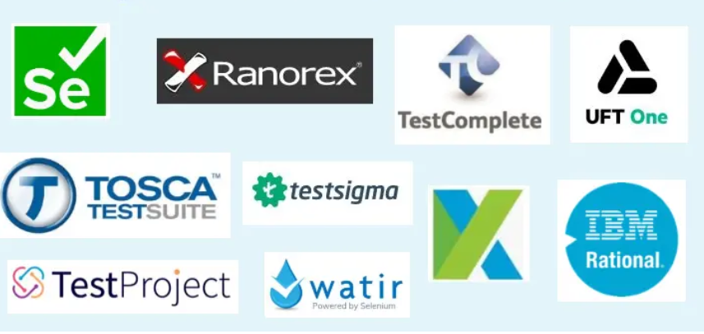
Manual Testing vs Automation Testing
Manual testing is executed manually while automation testing is done using an automation tool .
There are different types of automation tools in the market today which are commonly used by different companies as per their need and preference.
Like
Selenium
Cypress,
UTF etc
Test Automation:
Automated testing is a software testing technique that automates the process of validating the functionality of software and ensures it meets requirements before being released into production. With automated testing, an organization can run specific software tests at a lot faster pace than manual testers. Automated testing is best suited for large or repetitive test cases.

Slide 3
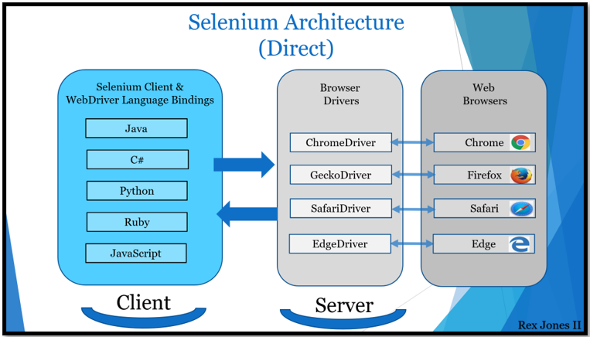
Selenium automation tool
Selenium is an open source (free) automated testing suite to test web applications. It supports different platforms, browsers and language bindings: .
Operation System Support – Windows, Mac OS, Linux, Solaris.
Browser Support – Mozilla Firefox, Internet Explorer, Google Chrome 12.0. 712.0 and above, Safari, Opera 11.5 and above, Android, iOS, HtmlUnit 2.9 and above.
Language Bindings - C#, Java, JavaScript, Ruby, and Python
Selenium automates browsers. That’s it! what you can do with that power is entirely up to you!
What is selenium ?

Slide 4
Selenium Components:
Selenium WebDriver
Selenium IDE
Selenium Grid
Selenium WebDriver(WebDriver drives a browser)
Selenium WebDriver is a browser automation framework that accepts commands and sends them to a browser. It is implemented through a browser-specific driver. It controls the browser by directly communicating with it.
Selenium IDE: A Firefox/chrome extension to record and play the user actions performed on a web page.
Selenium Grid: What is Selenium grid vs WebDriver?
Selenium WebDriver is an API that executes our test by driving a browser for automating an Application Under Test (AUT) while Selenium Grid executes our test across multiple browsers, operating systems, and machines.

Slide 5
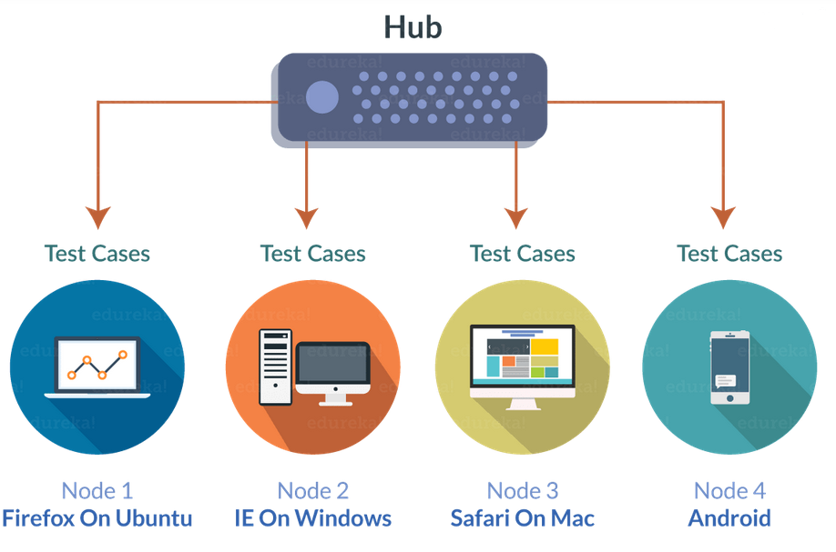
Selenium IDE
Selenium IDE (Selenium Integrated Development Environment):
It is the simplest framework in the Selenium Suite. It allows us to record and playback the scripts
It is a Chrome, Firefox and Edge add-on that will do simple record-and-playback of interactions with the browser.
Selenium Grid
Selenium Grid can be used to execute same or different test scripts on multiple platforms and browsers concurrently so as to achieve distributed test execution.
Advantages of Selenium Grid?
• It allows running test cases in parallel thereby saving test execution time.
• It allows multi-browser testing
• It allows us to execute test cases on multi-platform

Slide 6
Advantages of Selenium Automation Tool
• Free and open source
• Have large user base and helping communities
• Cross-browser compatibility
• Platform compatibility
limitations of Selenium WebDriver
• We cannot test windows application
• We cannot test mobile apps
• Limited reporting
• Handling dynamic Elements
• Handling page load
• Handling pop up windows
• Handling captcha

Slide 7
Work with Selenium WebDriver interface
To start writing selenium code, take the following steps:
Create a maven project
Import the required dependencies for your maven project
Import WebDriverManager
Initialize WebDriver interface
And use the WebDriver implementing classes
WebDriverManager.chromedriver(). setup ();
WebDriver driver = new ChromeDriver();
1)Maven is an automation and management tool developed by Apache Software Foundation.
It allows developers to create projects, dependency, and documentation using Project Object Model and plugins.
2)WebDriverManager is an open-source Java library that carries out the management (i.e., download, setup, and maintenance) of the drivers required by Selenium WebDriver (e.g., chromedriver, geckodriver, msedgedriver, etc.) in a fully automated manner
3) WebDriver interface: Selenium supports automation of all the major browsers in the market through the use of WebDriver.
WebDriver is an interface and implemented by its implementing classes like (ChromeDrive, EdgeDriver, InternetExplorerDriver, SafariDriver, RemoteWebDriver, ChromiumDriver ) and its superinterface is SearchContext.

Slide 8
WebDriverManager provides a set of managers for Chrome, Firefox, Edge, Opera, Chromium, and Internet Explorer.
The basic use of these managers is the following:
WebDriverManager.chromedriver().setup();
WebDriverManager.firefoxdriver().setup();
WebDriverManager.edgedriver().setup();
WebDriverManager.operadriver().setup();
WebDriverManager.chromiumdriver().setup()
WebDriverManager.iedriver().setup();
Interface WebDriver’s implementing classes:
ChromeDriver driver = new ChromeDriver();
FirefoxDriver driver = new FirefoxDriver();
InternetExplorerDriver driver = new InternetExplorerDriver();
InternetExplorerDriver driver = new InternetExplorerDriver();
EdgeDriver driver = new EdgeDriver();
etc

Slide 9
Using SetProperty in Selenium:
The other way to run our selenium code, we need to use System.setpropert.
Steps to take :
1) Install a Selenium library
Setting up the Selenium library for your favorite programming language.
https://www.selenium.dev/downloads/
Import the selenium library for your java language installed in your machine
Import those libraries or jar files into your project build path
2) Install browser drivers
Download the browser drivers into your machine
https://www.selenium.dev/documentation/webdriver/getting_started/install_drivers/
3) Setting up your system to allow a browser to be automated.
System.setProperty("webdriver.chrome.driver"," C:/browsersDrivers/chromedriver.exe");
System.setProperty("webdriver.chrome.driver", "C:\\browsersDrivers\\ChromeDriver\\chromedriver.exe");
System.setProperty("webdriver.chrome.driver", "C://browsersDrivers//chromedriver.exe");
4) Initialize WebDriver Interface
WebDriver driver = new ChromeDriver();
5) $) Write your first Selenium script
driver.get("https://corammerswork.ml/wordpress/test1/");
String Title = driver.getTitle();
System.out.println(Title);

Slide 10
Interface WebDriver Commands used to for browser automation:
//Browser navigation
driver.get("https://selenium.dev");
//Longer way
driver.navigate().to("https://selenium.dev");
driver.navigate().forward();
driver.navigate().back();
//Refresh the current page
driver.navigate().refresh();
Driver.quit();
driver.close();
driver.get("https://www.google.com/");
driver.manage().window().fullscreen();
Driver.manage().window().maximize();
Driver.manage.().window().minimize();
driver.manage().timeouts().pageLoadTimeout(Duration.ofSeconds(20));
driver.manage().timeouts().implicitlyWait(Duration.ofSeconds(10));
//Get browser info
driver.getTitle();
driver.getCurrentUrl();

