Slide 1
Topics
Colors
Fonts
Spacing

Slide 2
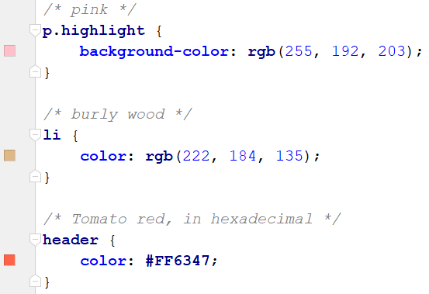
RGB colors
As seen, colors can be assigned given a name, such as: red, yellow, purple
For most elements
Background-color assigns that color behind an element
Color assigns the foreground of an element
Colors can also be assigned using the RBG (red-green-blue) system, where each color is given a value between 0-255
Format: rgb(red, green, blue

Slide 3
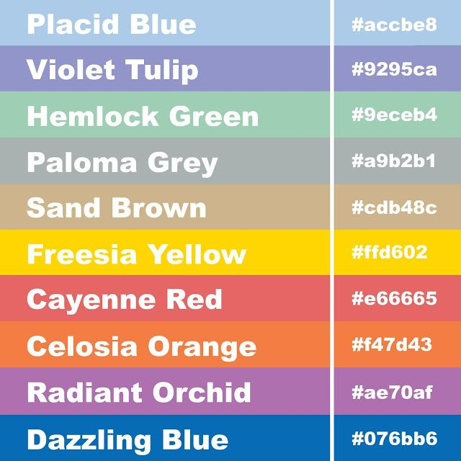
Hexadecimal values
An alternative number system to decimal numbers (base 10).
- Base 16
- Digits 0-9, A=10, B=11, C=12, D=13, E=14, F=15
Examples: #C01, #FF4D4D, #A379B
Used to summarize large numbers
RGB color values, web colors
- #FF0000 (red), #ADD8E6 (light blue)

Slide 4
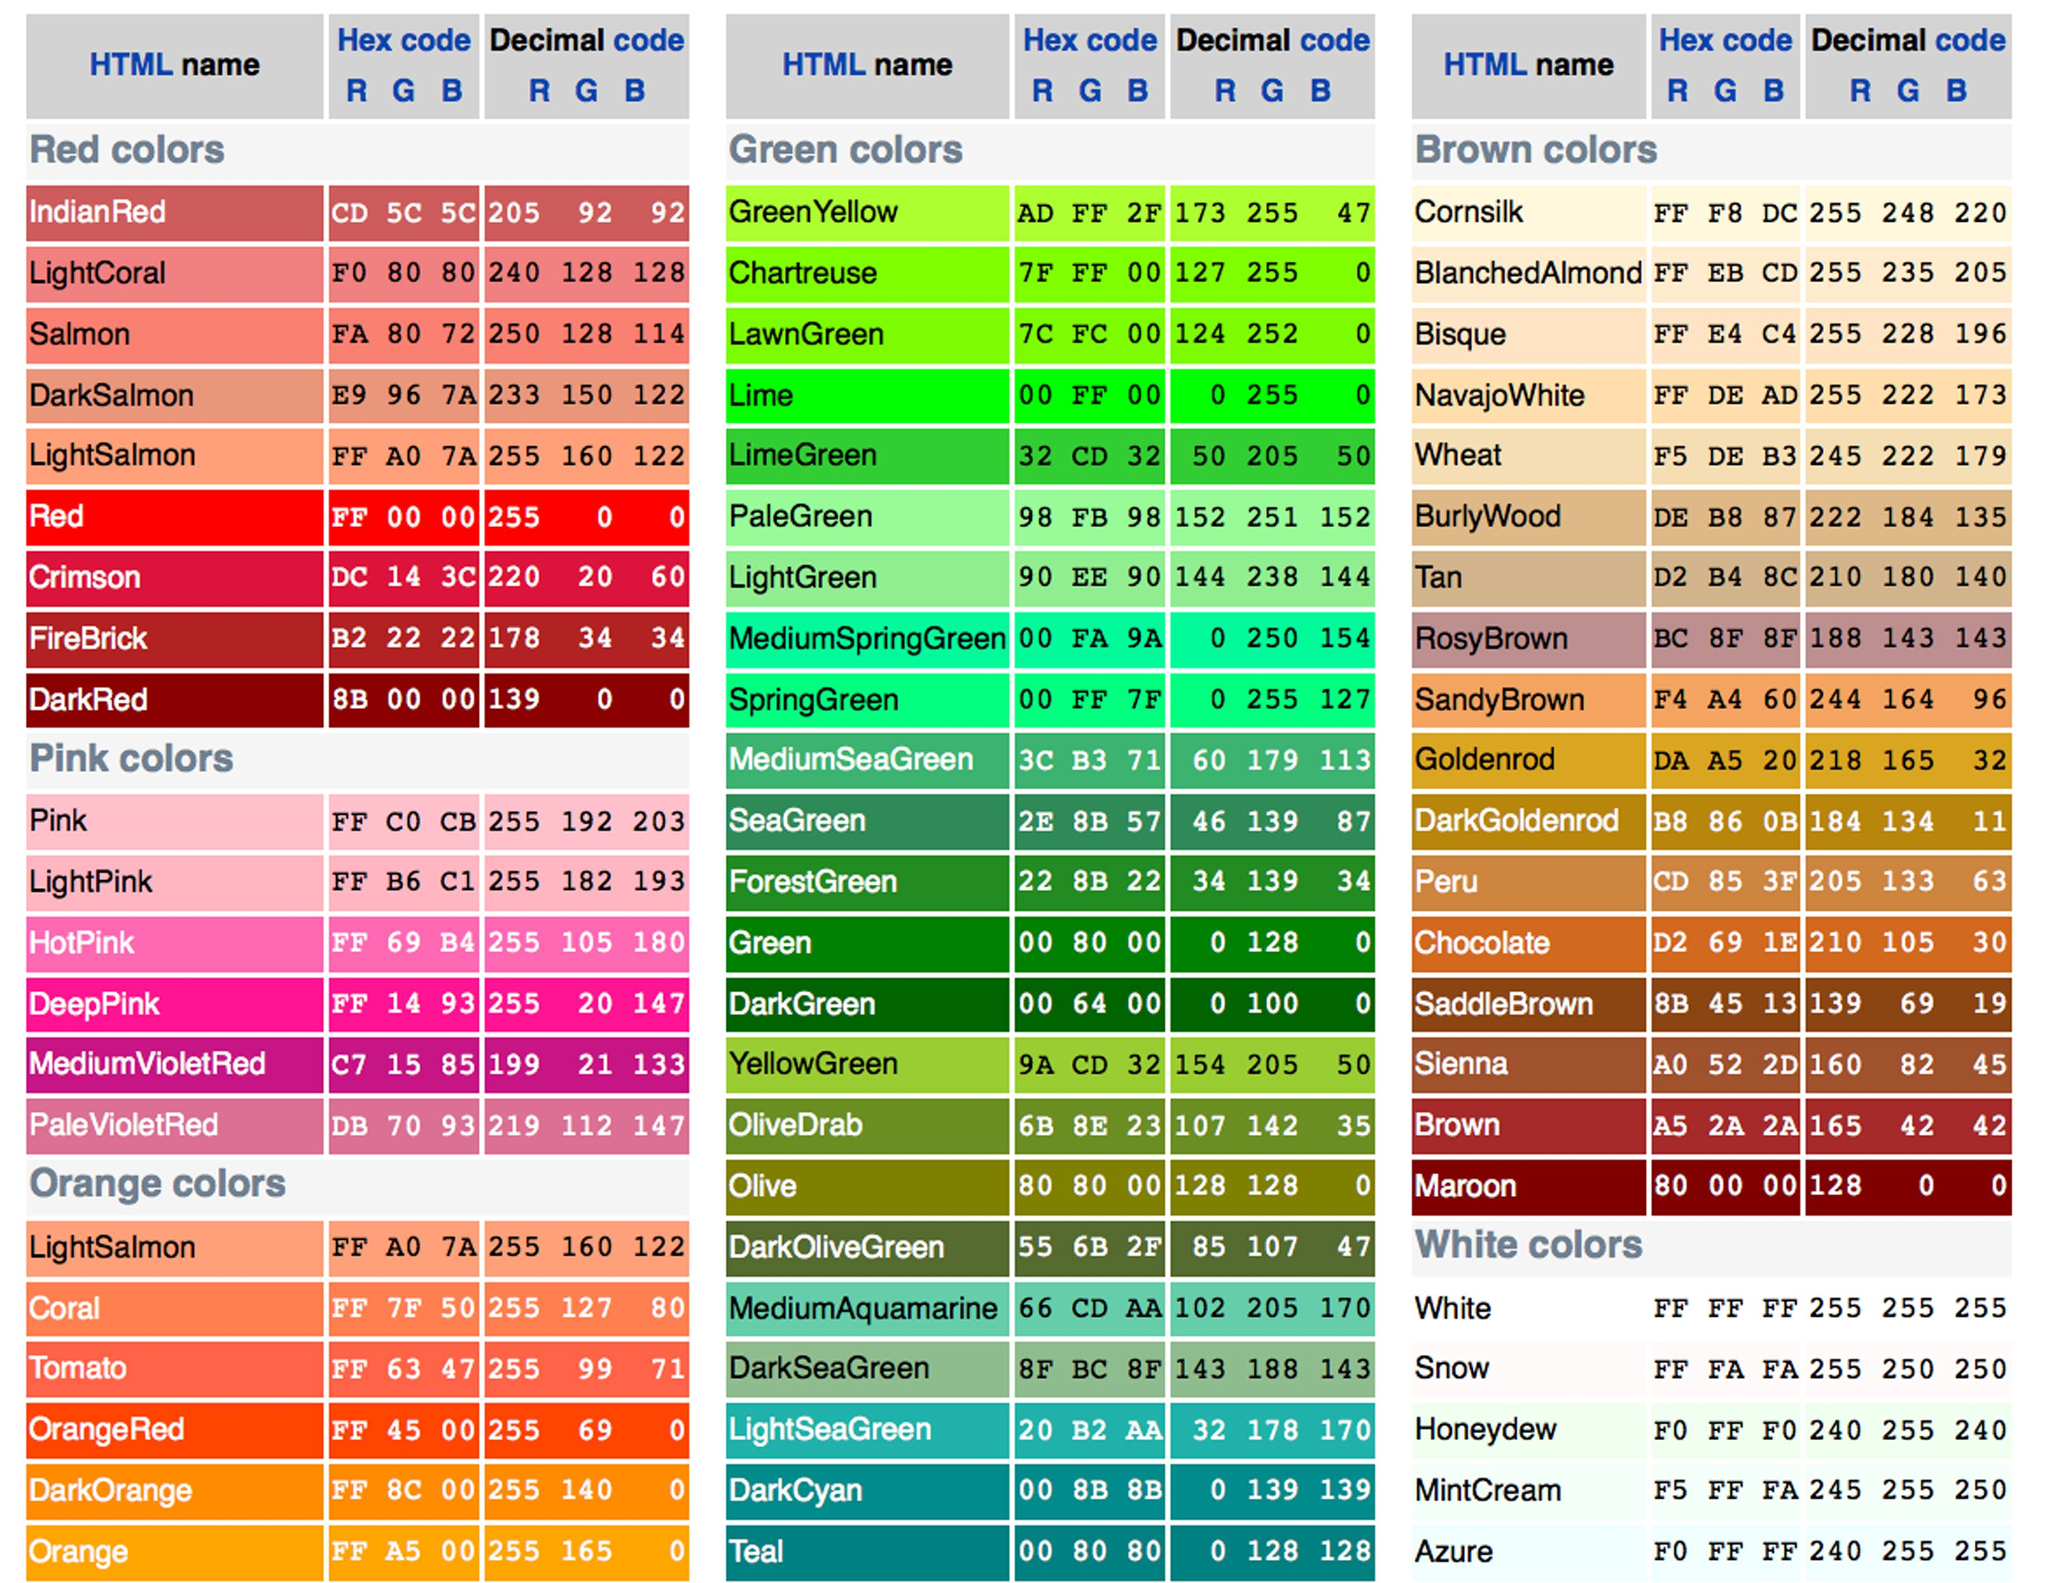
RGB Table

Slide 5
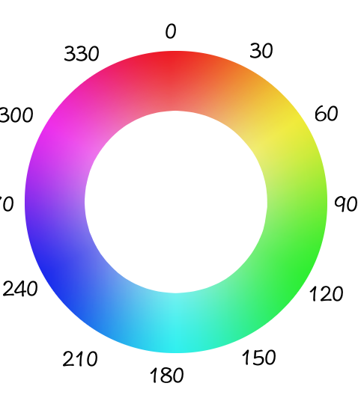
HSL colors
Another coloring system in CSS3 is the HSL system
Colors are defined to
- Hue: the tint of the color
- Saturation: the intensity of the color
- Lightness: the brightness of the color
Format: hsl(hue, saturation, lightness)
Example: hsl(180, 80%, 40%)

Slide 6
Font styles
Introduction to CSS

Slide 7
Font styles
Font styles: Part of designing a good-looking website is careful attention to typography
Typography: the art of designing the appearance of letters and characters on the page
Text characters are based on fonts
Font: defines the styles and shapes of a group of alphabetic characters

Slide 8
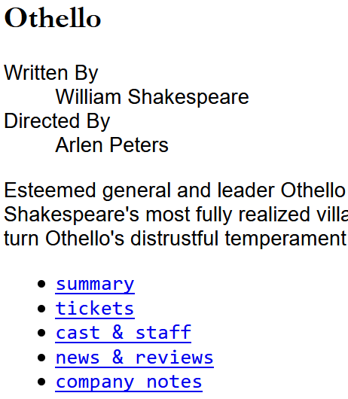
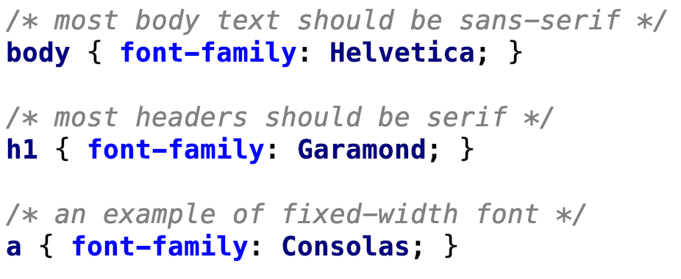
Types of fonts
Fonts can be grouped into broad categories
Serif
Sans serif
Monospaced
Fantasy
Script
Note: We primarily use the first three categories in a website

Slide 9
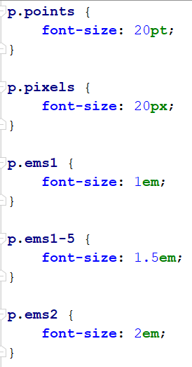
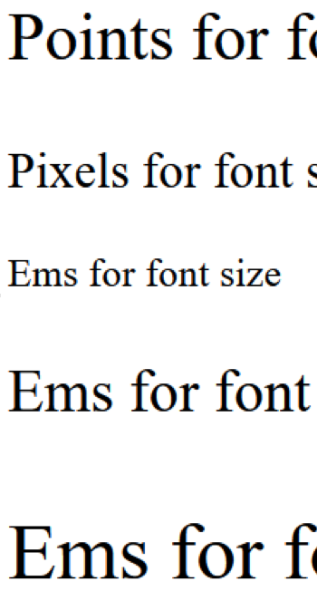
Font size
Format: selector {font-size: measurement}
Example: p {font-size: 2 em;}
Example measurements:
Points – 12pt
Pixels – 16px
Ems – 1.2em
Several keywords can be used in place of a measurement.
Keywords – xx-small, x-small, small, medium, large, x-large, xx-large

Slide 10
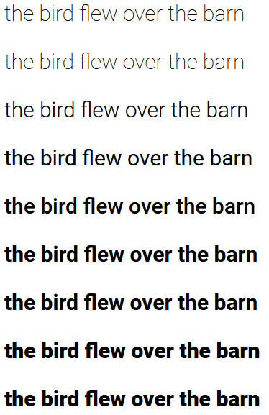
Font weight
Font weight can increase the density of characters on the screen
Format: selector {font-weight: value;}
Example: blockquote {font-weight: bold;}
Common values: normal, bold, bolder, lighter, 100-900
Note: not all fonts support each weight level

Slide 11
CSS Background
Definition: The CSS background properties are used to add background effects for elements.
In these chapters, you will learn about the following CSS background properties:
With CSS, a color is most often specified by:
a valid color name - like "red"
a HEX value - like "#ff0000"
an RGB value - like "rgb(255,0,0)"
background-color
background-image
background-repeat
background-attachment
background-position

Slide 12
Here, the <h1>, <p>, and <div> elements will have different background colors:
h1 { background-color: green; } div { background-color: lightblue; } p { background-color: yellow; }

