Slide 1
Topics
Introduction to flex boxes
Working with flex items
Alignment within a flex box

Slide 2
Introduction to flex boxes
CSS flex boxes allow you to arrange elements in rows or columns
Flex boxes are known to adjust themselves well, without the need to manage elements by the developer
Note: This is a one-dimensional layout, unlike two-dimensional layouts with CSS grid

Slide 3
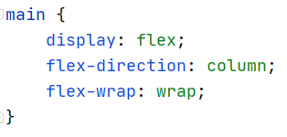
Defining a flex box
To define a flex box you will need to:
Set display: flex in a parent container
Set the flex-direction to row or column
Set the wrapping behavior using flex-wrap

Slide 4
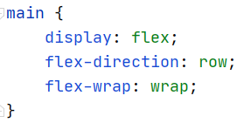
Defining a flex box
To define a flex box you will need to:
Set display: flex in a parent container
Set the flex-direction to row or column
Set the wrapping behavior using flex-wrap

Slide 5
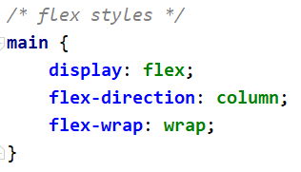
Example
Changing our flex box to a column will not move elements no matter how you resize your browser window.
Why?

Slide 6
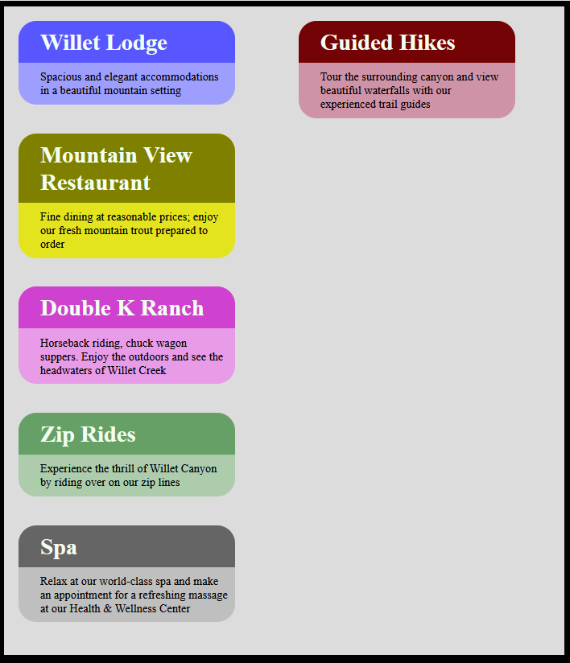
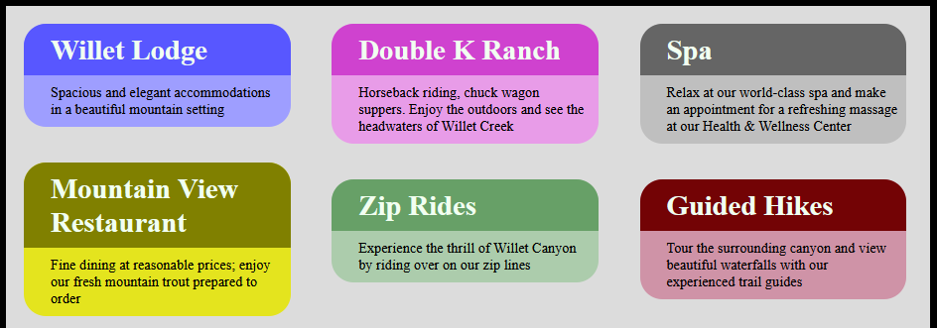
Example
When the height of the parent container is constrained then extra elements will spill into adjacent columns
.container { height: 900px; }
.container { height: 300px; }

Slide 7
Working with flex items
Flex Box

Slide 8
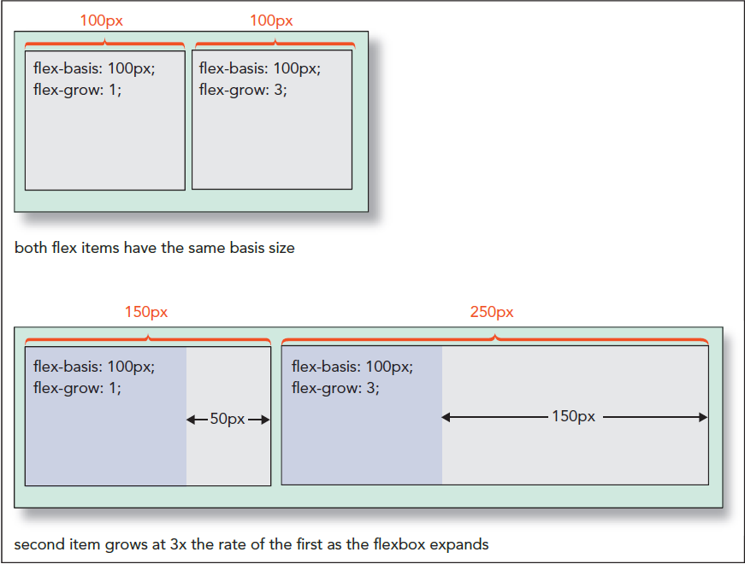
Working with flex items
You can alter the size of elements in a flex box using the following properties:
Flex-basis: the initial size of a child element
Flex-growth: the relative rate at which an element grows
Flex- shrink: the relative rate at which an element shrinks

Slide 9
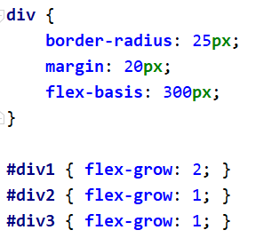
Flex basis size
300px
Resize rate 2x
Resize rate 1x
Flex
grow

Slide 10
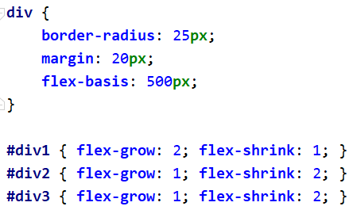
Shrink rate 1x
Shrink rate 2x
Flex basis size
500px
Flex
shrink

Slide 11
Alignment within a flex box
Flex Box

Slide 12
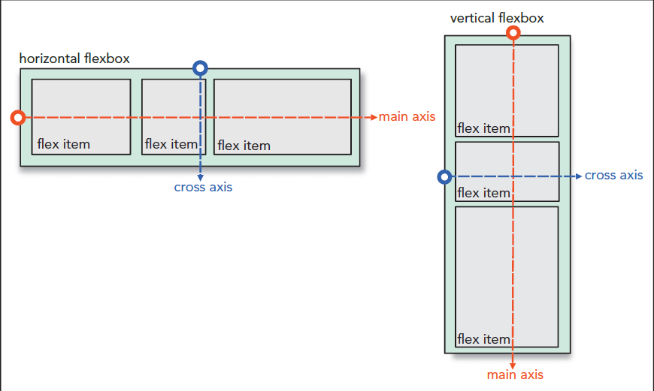
Flex box axis
Elements in a flex box can be arranged around the
main axis - horizontal for rows, vertical for columns
cross axis - the opposite axis from the main axis

Slide 13
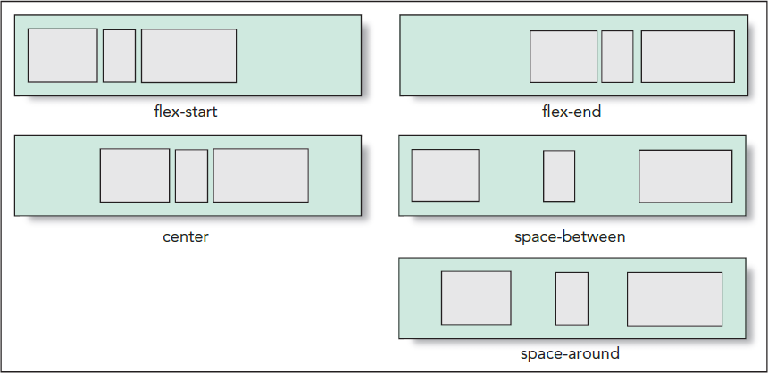
justify-content
Elements can be justified along the main axis grouping or spreading out elements
To align elements you can use the justify-content property with one of the following values: flex-start, flex-end, center, space-between, space-around

Slide 14
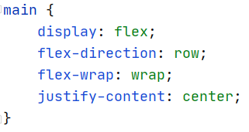
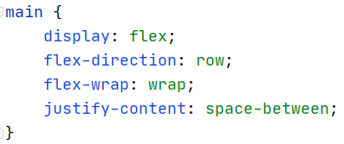
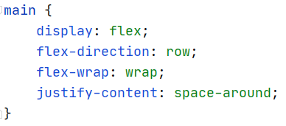

Slide 15
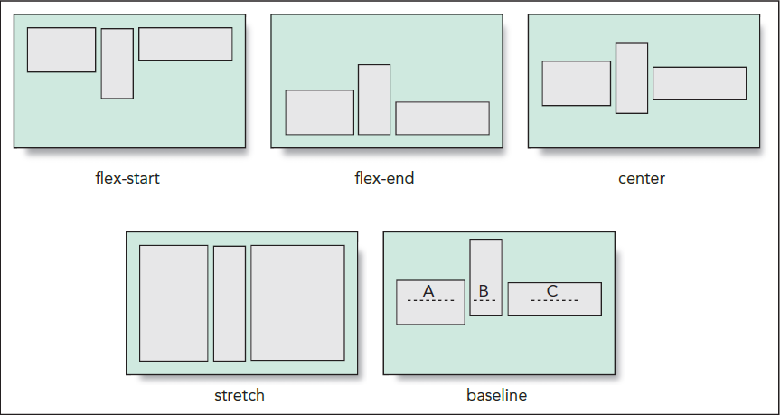
align-items
Items can be adjusted along the cross axis
To align rows of elements you can use the align-items property with one of the following values: flex-start, flex-end, stretch, center, baseline

Slide 16
