Slide 1
CSS Grid
SDEV 106

Slide 2
Topics
What is CSS grid?
Creating a grid
Line-based placement
Grid template areas
Resources

Slide 3
What is CSS grid?
CSS Grid

Slide 4
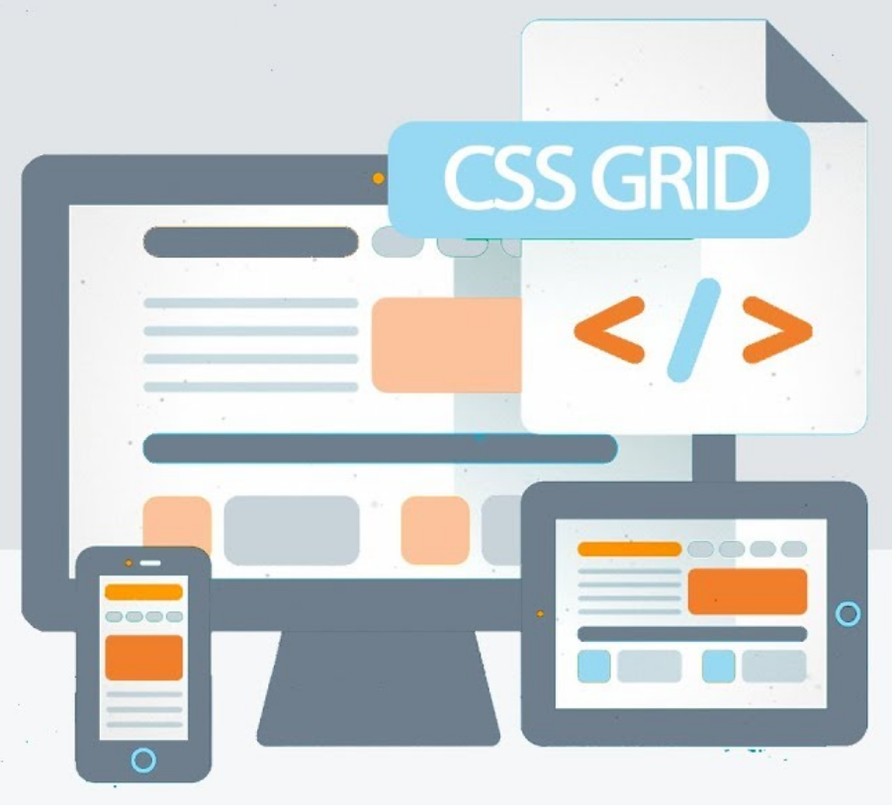
What is CSS grid?
CSS grid is a two-dimensional layout system
CSS grid allows us to:
create grid-based layouts
remove much of the bloated markup from frameworks like Bootstrap
flexibly update the grid (for example, on mobile devices)

Slide 5
Why do we need this?
Separation of concerns: we are striving to keep our page structure, styles and behavior separated.
<!doctype html>
<html lang="en"> ... </html>
HTML
h1 { font-size: 1.2em; }
let numRecords = 10;
if (numRecords == 0) {
console.log("missing");
}
CSS
Javascript

Slide 6
Creating a Grid
CSS Grid

Slide 7
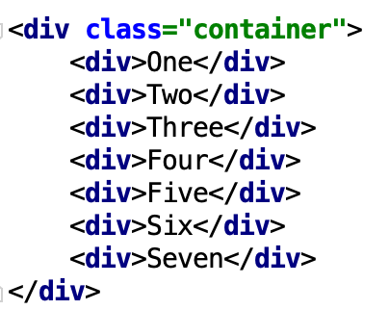
Display - grid
To create a CSS grid layout, you will need:
a parent element that acts as a container for the grid
child elements that are placed in the grid
The parent element is given the grid display property
The markup for this example can be found here

Slide 8
Setting columns
Using the display type grid is not enough to achieve a grid layout
You must then declare how your columns and rows behave in the grid
You can declare columns using the grid-template-columns property
Each column is given a measurement within the template

Slide 9
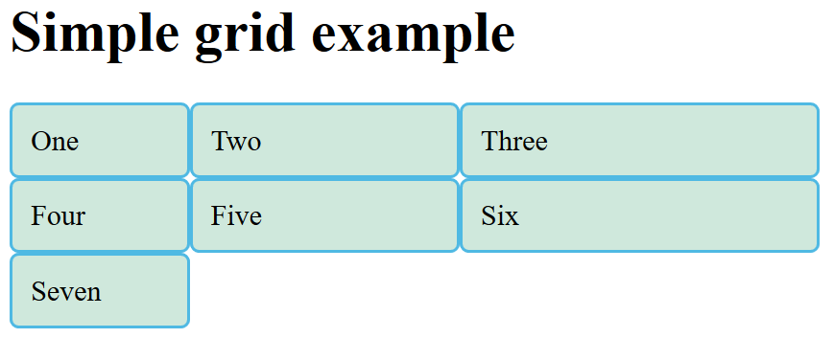
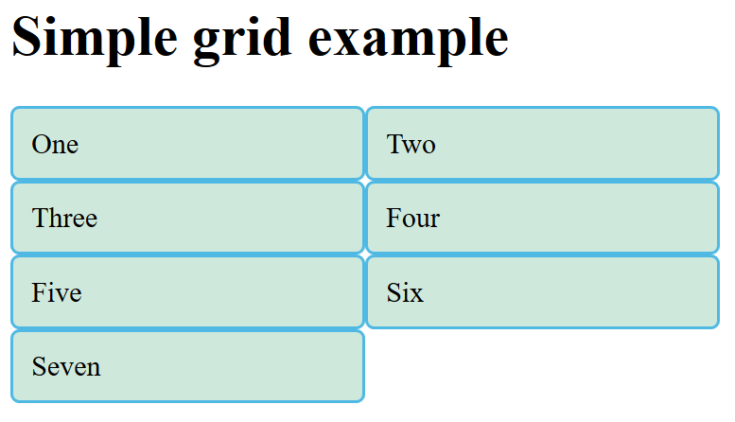
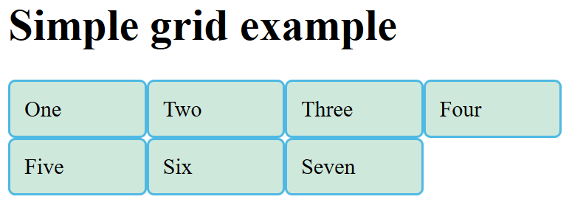

Slide 10
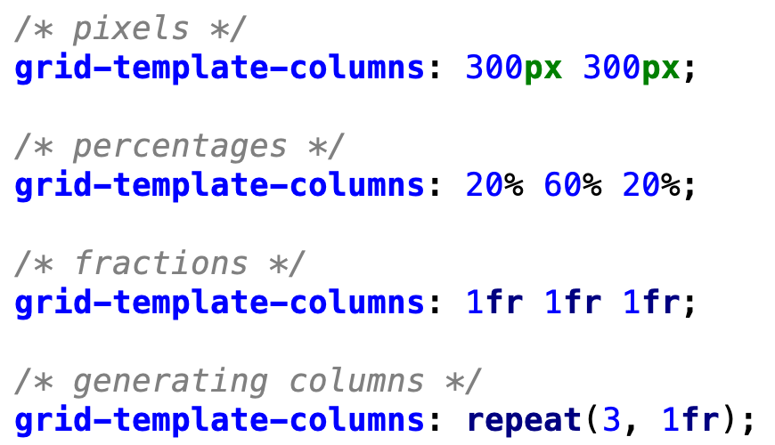
Setting columns
Different types of measurements can be used
Including the new fraction (fr) unit, which sizes columns relative to one another
Note:
Setting columns is an explicit action
Rows created are implicit based on the number of columns given (although you can declare row sizes)

Slide 11
Using fractions
1fr
1fr
2fr
1fr
Fractional units determine their size bases on all other fractional units
This leads to a simple, elegant way to define groups of relative values
1/5
1/5
2/5
1/5

Slide 12
Examples
2fr
2fr
1fr
1fr
1fr
2/5
2/5
1/5
1/2
1/2
1fr
1fr
1fr
3fr
1fr
1fr
2fr
1fr
1/7
1/7
1/7
3/7
1/7
1/4
2/4
1/4

Slide 13
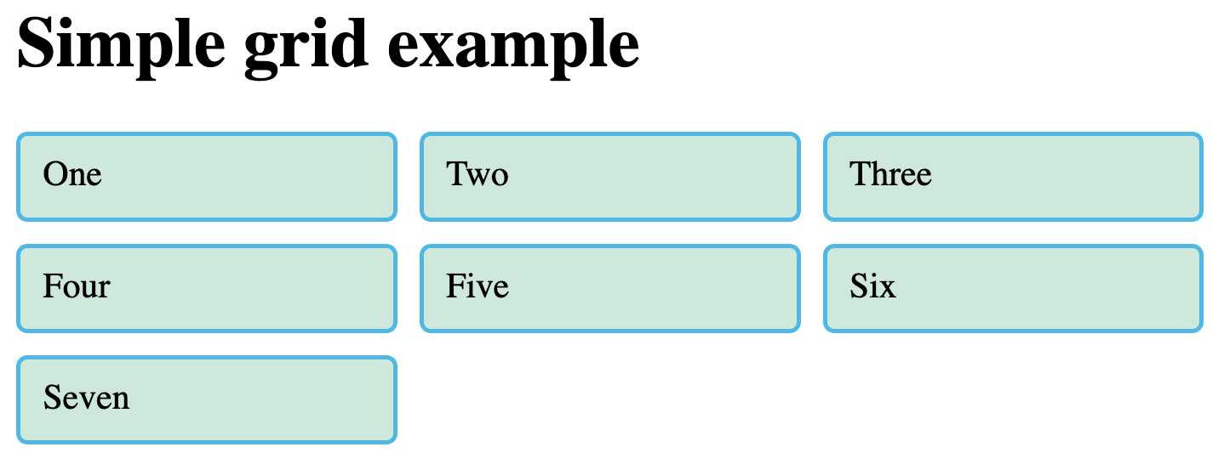
Creating gutters
You can easily create gutters in the grid with the grid-gap property
Note: This is much harder to do with float-based layouts

Slide 14
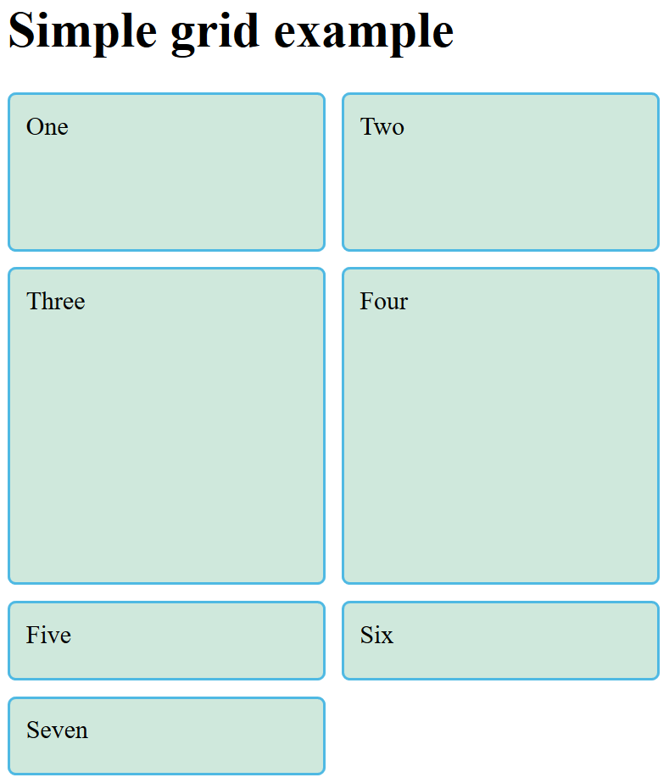
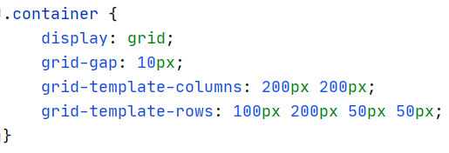
Managing row height
Rows will grow to fill the contents of cells in that row
You can set a size for a row using the grid-template-rows property
Note: It can be hard to achieve this effect with other CSS properties

Slide 15
Line-based Placement
CSS Grid

Slide 16
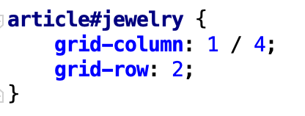
Line-base placement
1
2
3
4
5
The markup for this example can be found here
Elements can also be placed based entirely on their position in the grid
i.e. without respect to:
their position within the HTML markup
their position within a parent element
Elements are placed using the grid-column and grid-row properties
1
2
3
4

Slide 17
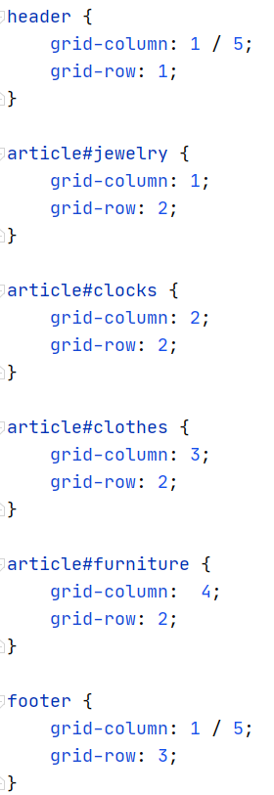
Example
1
2
3
4
5
1
2
3
4

Slide 18
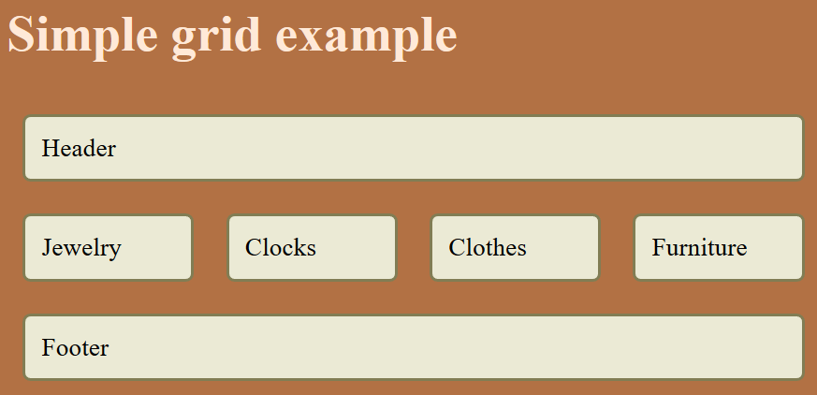
Example

Slide 19
Grid Template Areas
CSS Grid

Slide 20
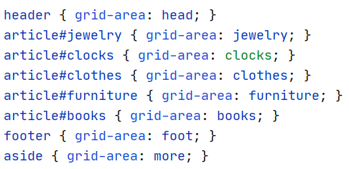
Grid template areas
The markup for this example can be found here
Probably the most useful feature of CSS grids it the ability to visually build a grid
Steps:
Name your grid regions using the grid-area property
Use the grid-template-areas property on your grid container to assign cells visually
First, we name
our regions

Slide 21
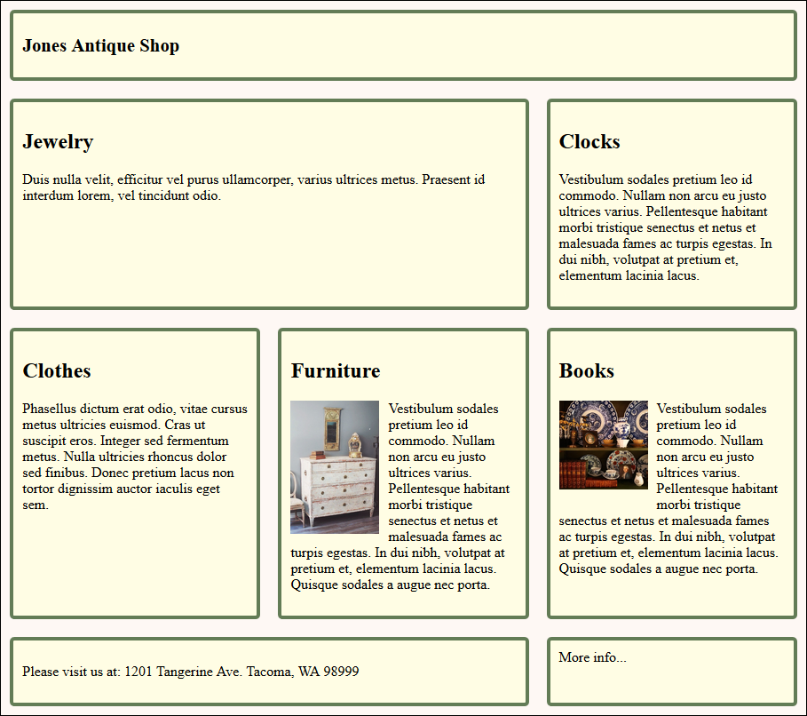
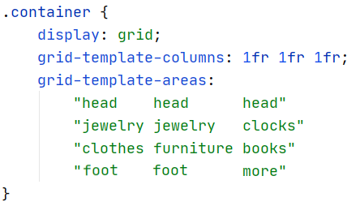
Grid template areas
Next, we place
our elements visually

Slide 22
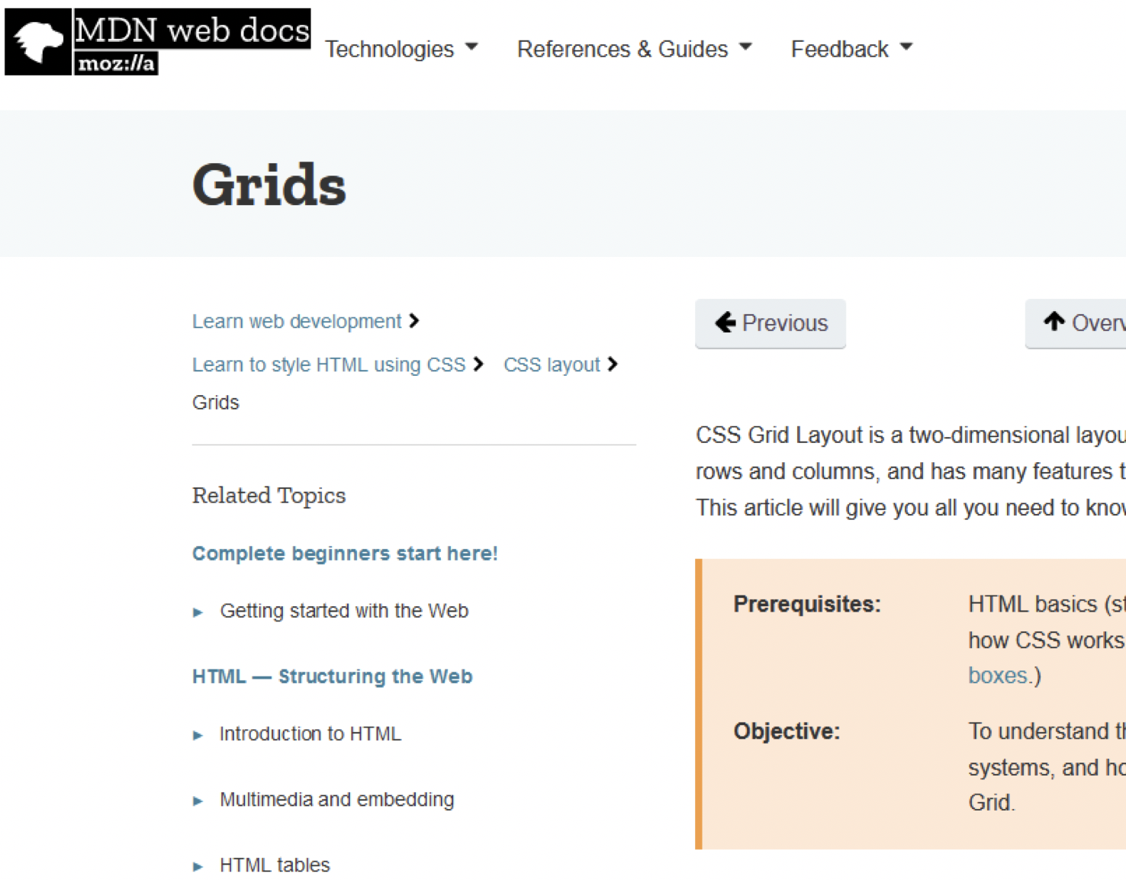
More resources for the curious
MDN
Introduction, Documentation
Tutorials
Auto-placement in CSS Grid Layout
Basic Concepts of grid layout
Line-based placement with CSS Grid
Grid template areas
Video tutorial (2017) – link
A great presentation on the future of the web and CSS Grid - link

