Slide 1
Introduction to JS

Slide 2
Topics
Introduction
The web landscape
Script basics

Slide 3
Javascript
What Javascript is...
What Javascript is NOT...
The programming language of the web
Used to make a web page interactive
prompt user for information
dynamically display information to user
respond to user-initiated events
provide useful functionality, like form validation
animate elements of the page
and much more!
Javascript is not
Java
strongly-typed
stand-alone
useful for file I/O (except cookies)
used for connecting to a database

Slide 4
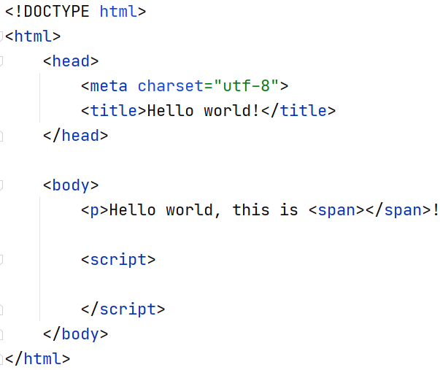
Writing Javascript code
Let's write a first program using Javascript
To include Javascript within a web page, we can use the <script> element
JS code goes here

Slide 5
Writing Javascript code
A code comment is informative,
but doesn't perform an actions
Create a variable and store
the <span> element in it
JS statements end
with a semicolon
Use a CSS selector

Slide 6
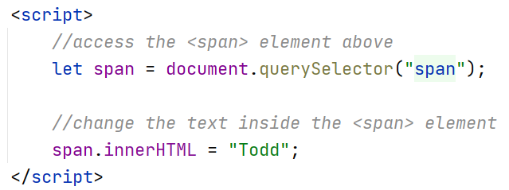
Writing Javascript code
Assign new contents to
the <span> element

Slide 7
Script basics
Introduction to JS

Slide 8
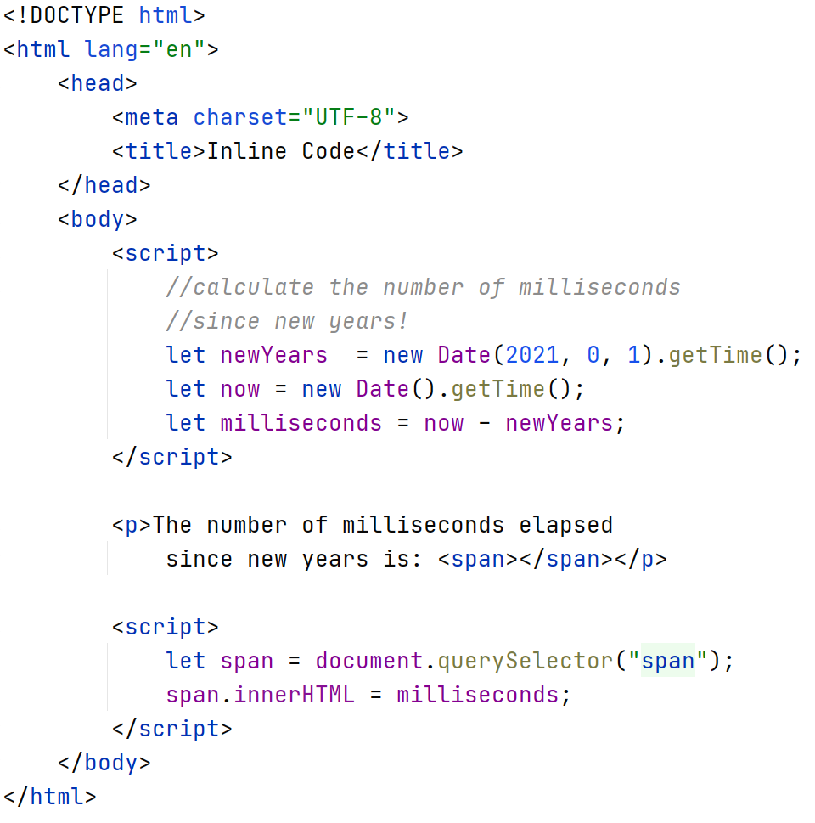
Inline JavaScript
Javascript code within <script> tags is called inline Javascript
Inline code is typically located within the <head> or <body> elements
The scripts are executed in order, from top to bottom in the document
1. Calculate values
2. Assemble DOM
3. Interact with DOM

Slide 9
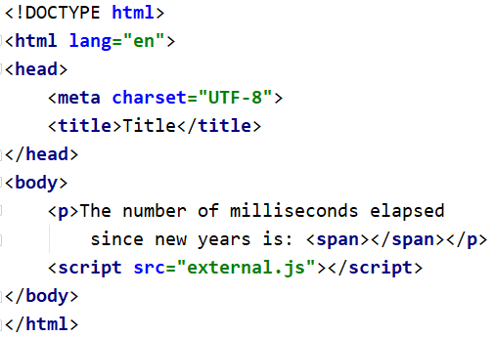
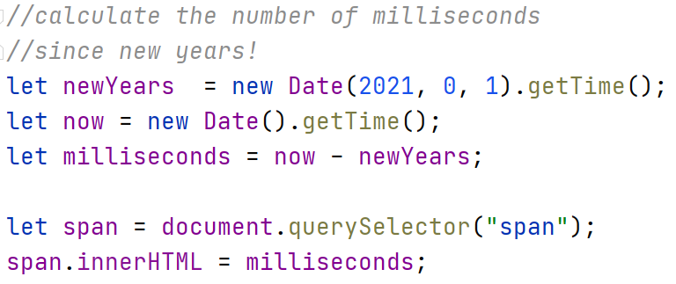
External JavaScript
JavaScript code can also be in external files with a .js extension
We set the src attribute on a <script> element to reference the external script
This is the preferable method:
This creates a separation of concerns in our code
This makes our projects easier to maintain and organize
page.html
script.js

Slide 10
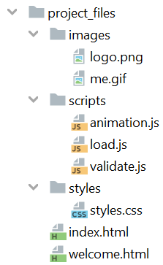
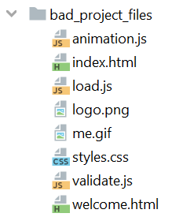
Let's get organized!
Now that we have more than three types of files in our application (HTML, CSS, JavaScript, images, etc...) we need to be organized
You can organize your files by type or by theme within your website
How you organize is up to you, but be organized!

Slide 11
The web landscape
Introduction to JS

Slide 12
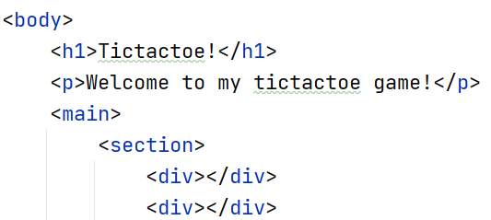
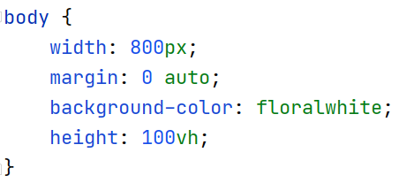
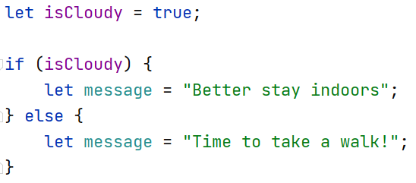
The 3 Layers of a Web Page
Content (HTML)
The text and images that the viewer sees
Determines the hierarchical structure
Style (CSS)
How the document appears on various devices
Colors, borders, fonts, etc.
Behavior (Javascript)
Allows the page to perform some action
Respond to user events

Slide 13
Prerequisite Knowledge
Content: You should be familiar with HTML elements and layouts.
Styles: You should also be familiar with CSS stylesheets
Do you know your selectors?
Do you remember how the box model works?
Can you create a grid layout?
If you are rusty, here are some resources:
HTML documentation on MDN
CSS documentation on MDN

Slide 14
How It Works – Client/Server Architecture
Client
Server
Request
Response
Specialized machine - Expensive, high-end, memory and CPU
Commodity machine - inexpensive memory, CPU
Network

Slide 15
Traditional Client-side development
<!doctype html> <html> <head> … </head> …
</html>
Client
Server
Render
HTML
CSS
Request: file.html
Response: file.html, file.css, file.js
.highlight { font-weight: bold }
var amount = 1.99;
if (amount < max) { //do something }
Execute
JavaScript
Network

Slide 16
Where we are headed (BAS)
Client
Server
Server-side Language
PHP
C#
Python
Request: file.php
Database Postgres
SQL Server
MySQL
Oracle
Response: file.php, file.css, file.js
Network
Dynamic pages based on persistent data

Slide 17
Where we are headed (the industry)
<!doctype html> <html> <head> … </head> …
</html>
Client
Server
Render
HTML
CSS
1. Initial Request/Response
2. Asynchronous JavaScript
(AngularJS, ReactJS, etc...)
.highlight { font-weight: bold }
var amount = 1.99;
if (amount < max) { //do something }
Execute
JavaScript
Network

Slide 18
How we will develop this quarter
<!doctype html> <html> <head> … </head> …
</html>
Client
Server
Request
Render
HTML
CSS
Local Web Server
(localhost)
.highlight { font-weight: bold }
Response
Commodity machine - inexpensive memory, CPU
var amount = 1.99;
if (amount < max) { //do something }
Execute
JavaScript

