Slide 1
Allah الله
AR- RAHMAAN ٱلْرَّحْمَـانُ ( The Beneficent )
Human بشر
Kalimah Tayyibah
faith ( Iman ) BELIEVES إِيمَان
The oneness Of Allah توحيد
Prophet and Messenger (nabi, نبی ) and( rasul, رسول )
Kalimah Shahadah
Allah , the Sustainer ٱللَّهُ ٱلصَّمَدُ
Creation of Allah هَٰذَا خَلۡقُ ٱللَّهِ
Creator ( al-Khaaliq ) ٱلْخَالِقُ

Slide 2
Allah الله
Kalimah Tayyibah
The oneness Of Allah توحيد
Kalimah Shahadah
Allah , the Sustainer ٱللَّهُ ٱلصَّمَدُ
Creation of Allah هَٰذَا خَلۡقُ ٱللَّهِ
Creator ( al-Khaaliq ) ٱلْخَالِقُ
AR- RAHMAAN ٱلْرَّحْمَـانُ ( The Beneficent )
Human بشر
faith ( Iman ) BELIEVES إِيمَان
Prophet and Messenger (nabi, نبی ) and( rasul, رسول )

Slide 3
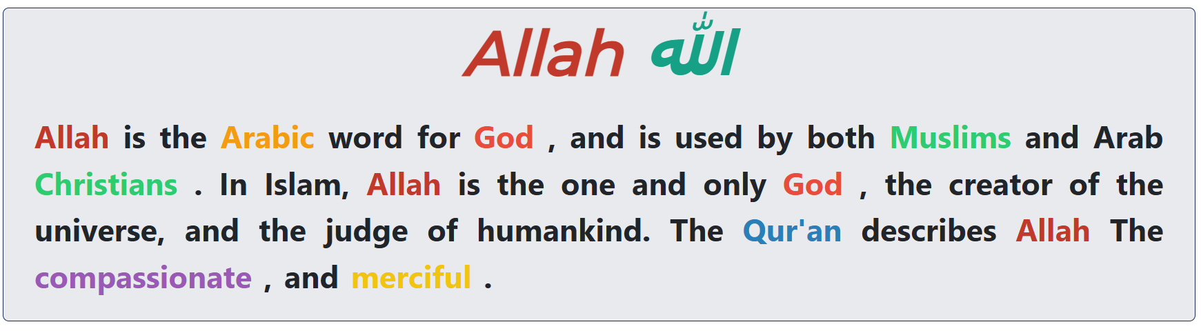


Slide 4
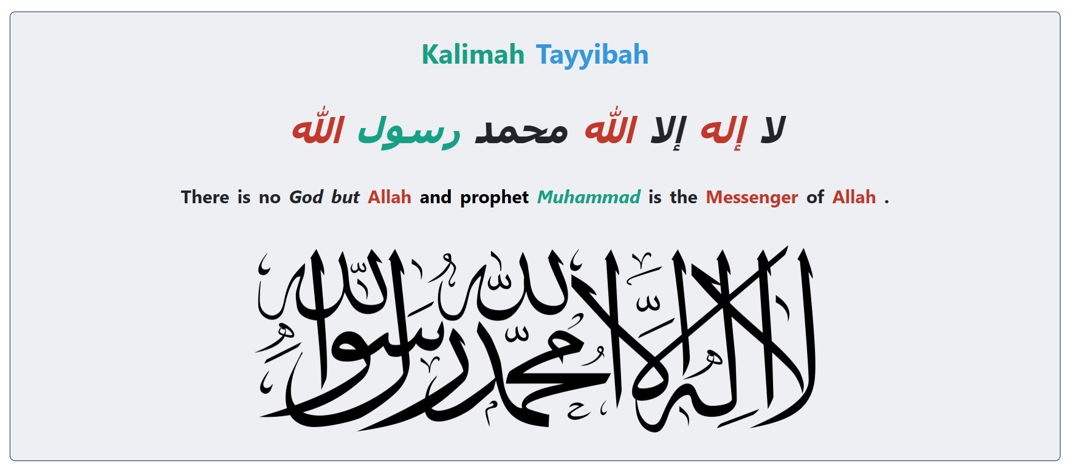

Slide 5
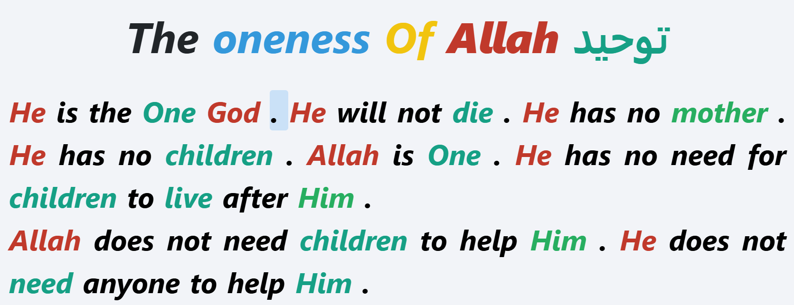

Slide 6
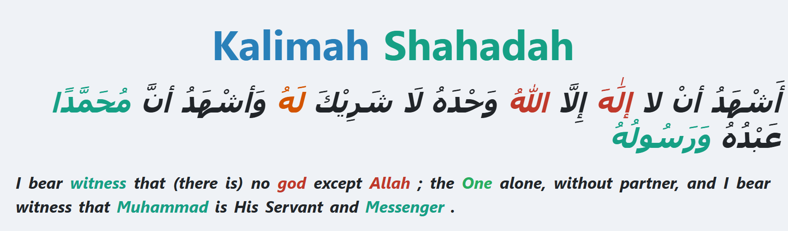

Slide 7
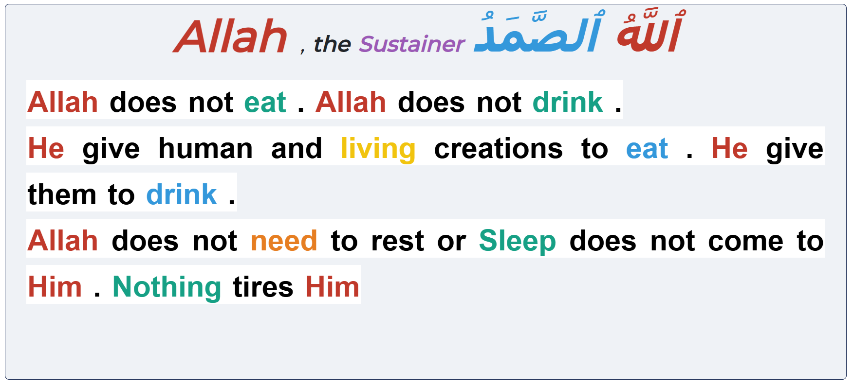

Slide 8
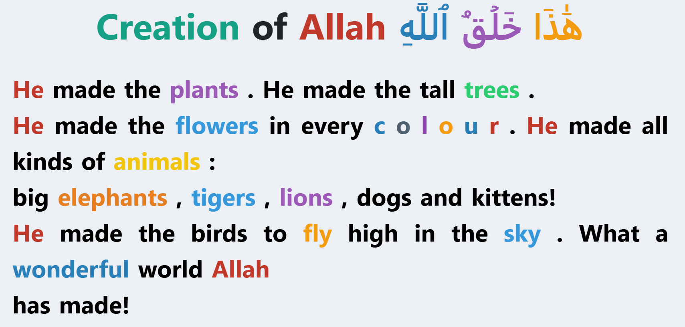

Slide 9
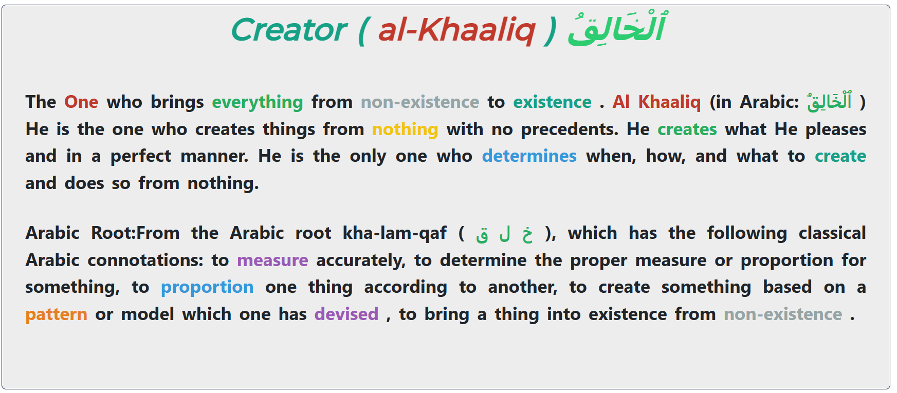

Slide 10
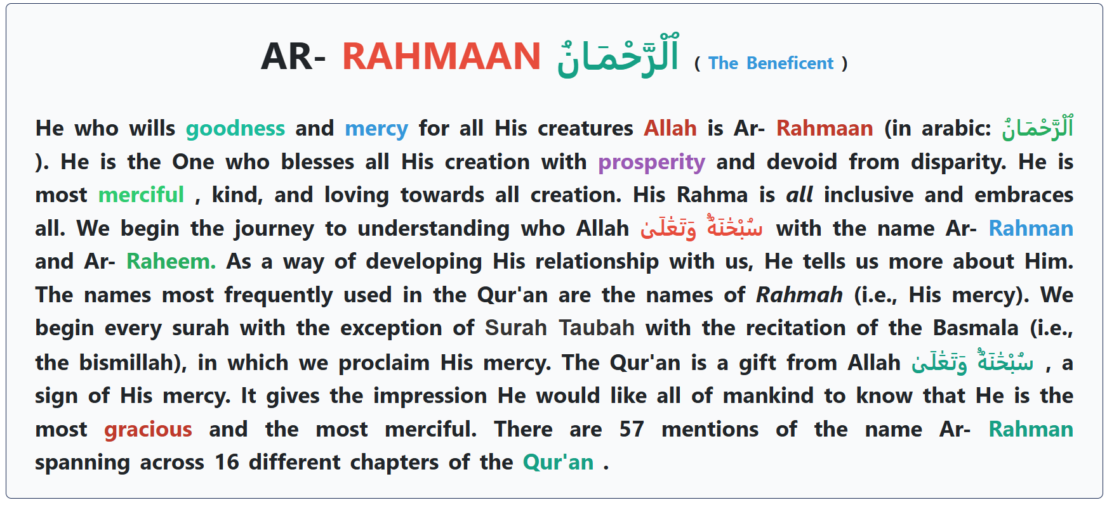

Slide 11
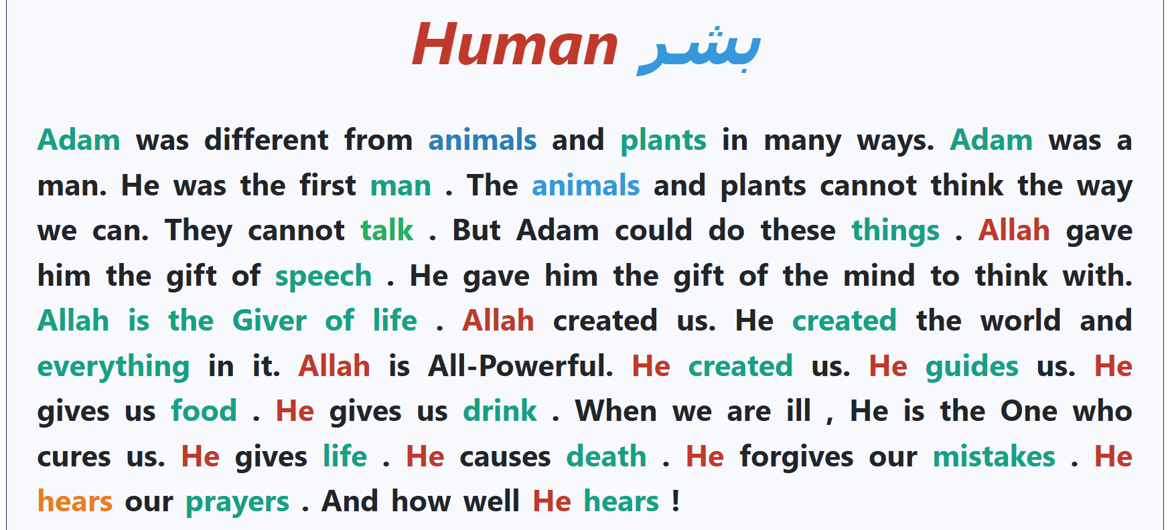

Slide 12
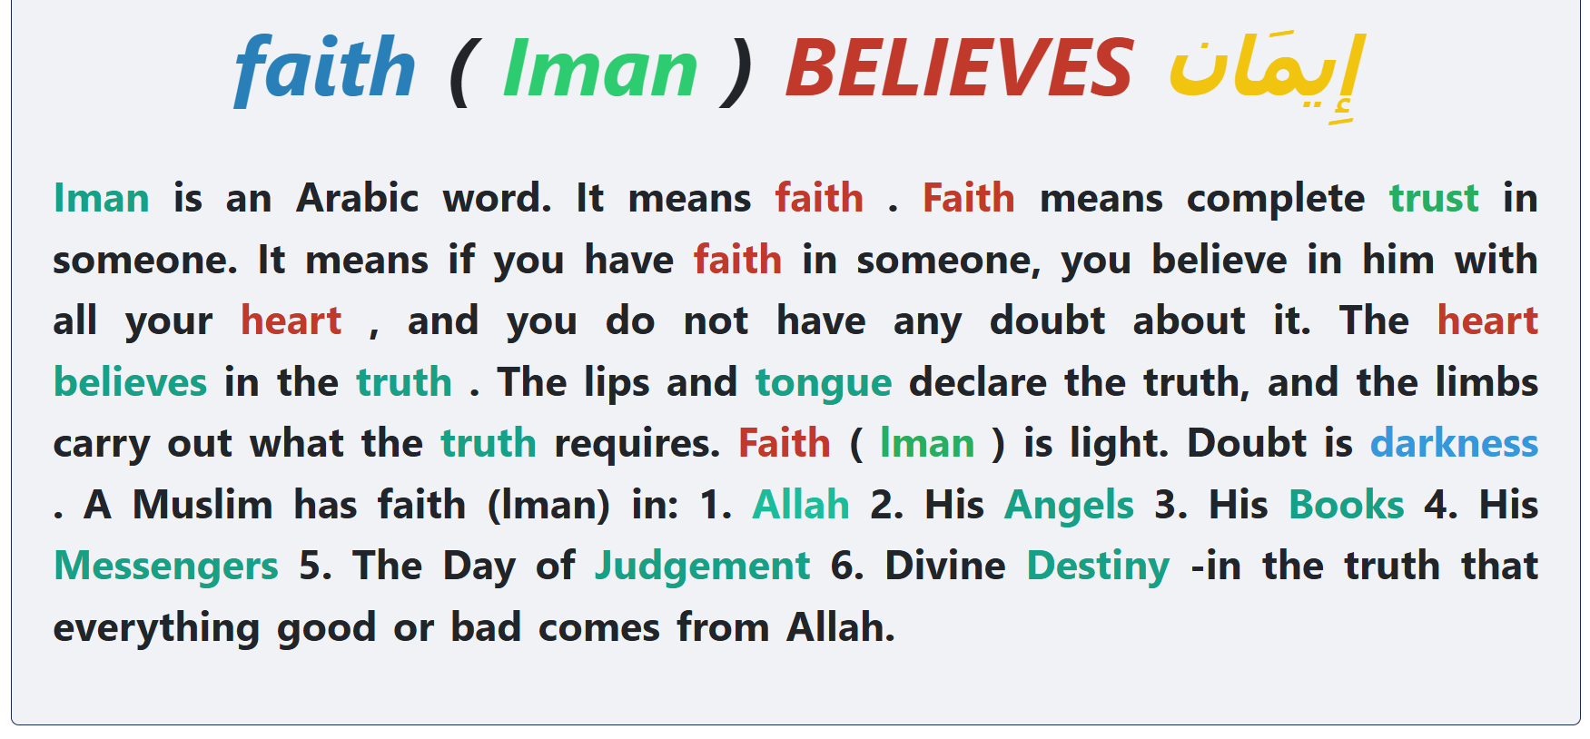

Slide 13
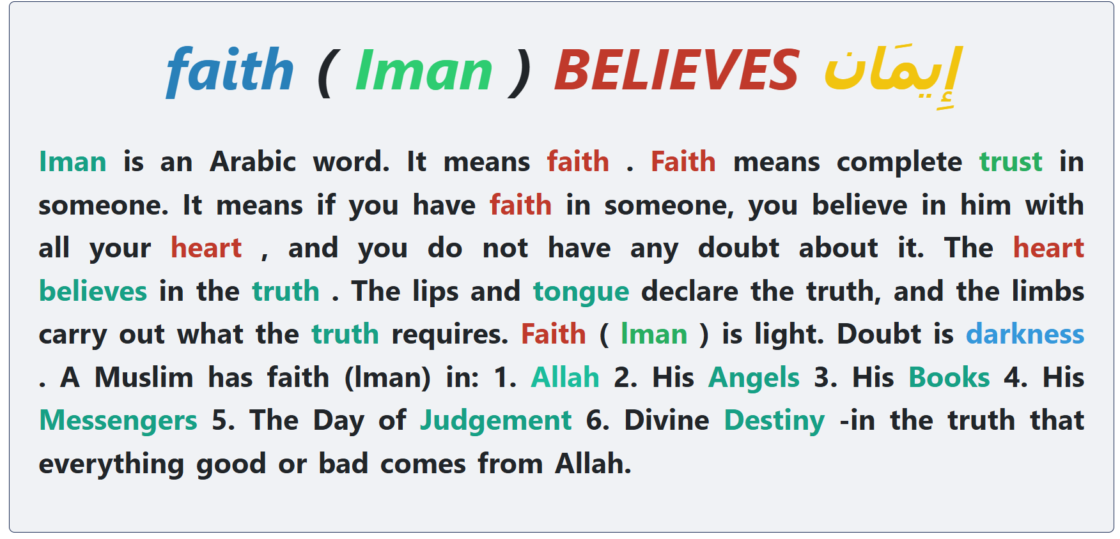

Slide 14
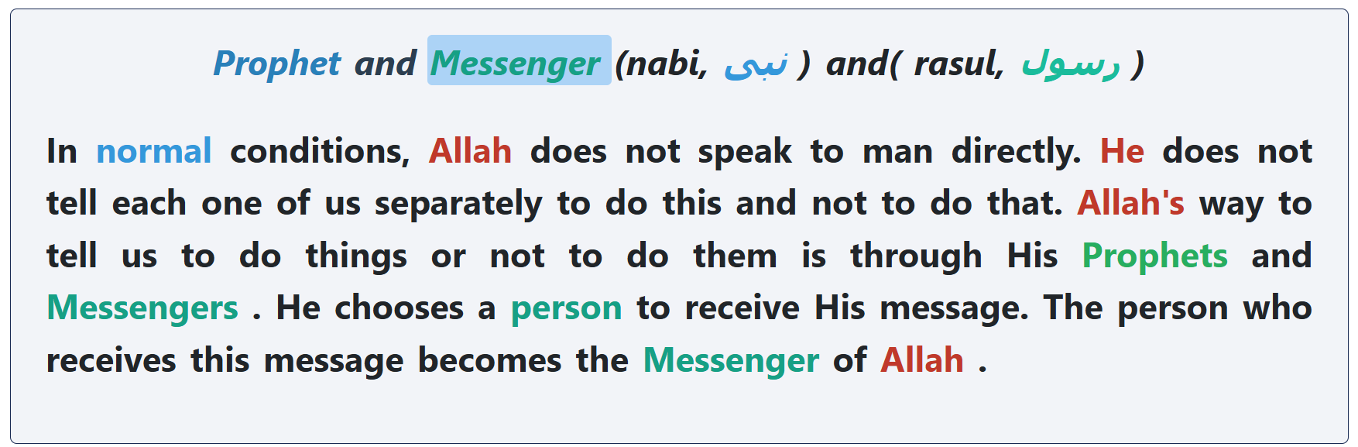

Slide 15
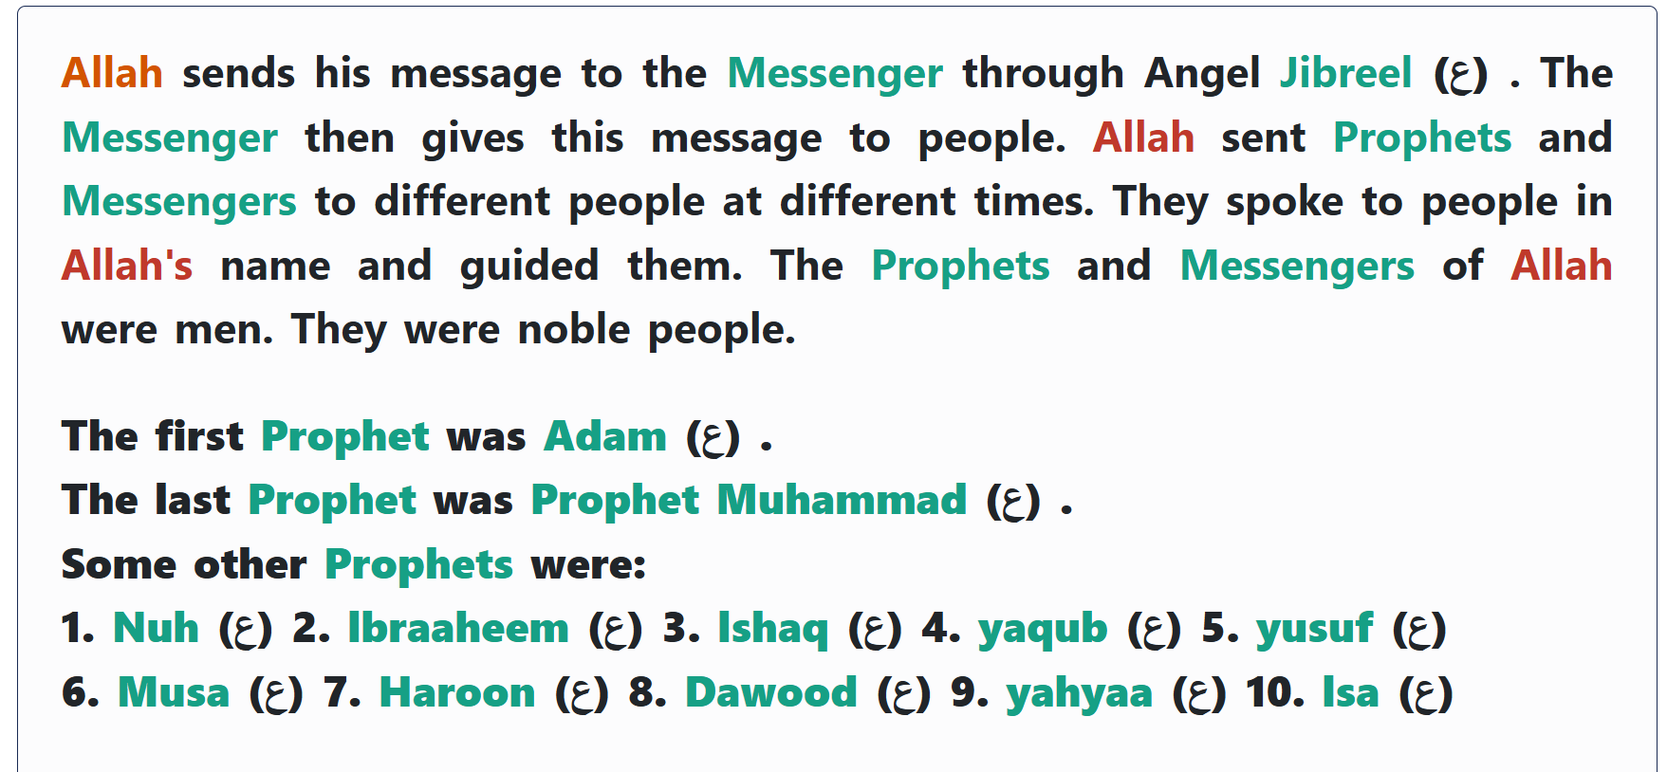

Slide 16
Test of the first two weeks

