Slide 3
Structured Query Language

Slide 4
PART ONE:
What is SQL
What are the followings ?
Data
Data Base
Database Management System
Types of Database Management Systems
Primary & Foreign keys
Data Base Components- Client & Server
Data Base & Schema

Slide 5
Structured Query Language(SQL)
SQL is structured query language.
This language is used for interacting with database.
For example:
When you enter username and password at some website it goes to server and check if it is valid.
Because your username and password is already stored in database somewhere.
To interact with database, SQL is needed.
In simple terms, you have to speak in the language that is understood by database engine. And that language is SQL.
Example :To display your customer’s information on a web page you will store all customer’s related data at a particular table on a database, in case of need you can easily retrieve , update or delete that customer’s data in that specific table in the database.
Now to interact with data or to manipulate or anything related to data….you should know a language which is …SQL.

Slide 6
Basics:
Data
Data Base
Database Management System
Types of Database Management Systems
Primary & Foreign keys
Structured Query Language(SQL)
Data Base Components- Client & Server
Data Base & Schema

Slide 7
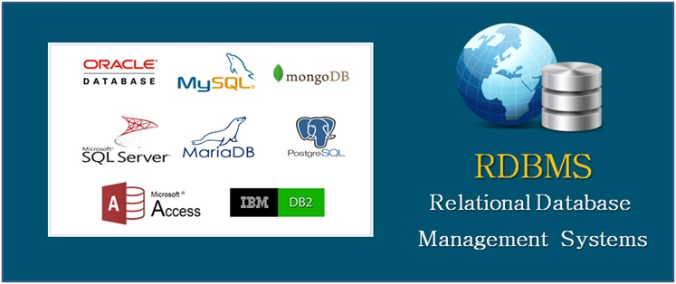
What is Data What is Database What is DBMS (Database Management Systems)
What is Data?
Data is a collection of a distinct small unit of information. It can be used in a variety of forms like text, numbers, media, bytes, etc. it can be stored in pieces of paper or electronic memory, etc.
What is Database
A database is an organized collection of data, so that it can be easily accessed and managed.
You can organize data into tables, rows, columns, and index it to make it easier to find relevant information.
Database Management system:
Database Management Systems (DBMS) are software systems used to store, retrieve, and run queries on data. A DBMS serves as an interface between an end-user and a database, allowing users to create, read, update, and delete data in the database.
There are many different Database Management Systems available like MySQL, PostgreSQL, Oracle, SQL Server, Ms-Access etc
The main purpose of the database management system is to operate a large amount of information by storing, retrieving, and managing data.

Slide 8
Types of Databases
There are different types of databases today in the market used by different companies as per their needs and requirements like :
Relational databases:
Distributed databases:
Centralized database:
Cloud databases:
Data warehouses:
etc

Slide 9
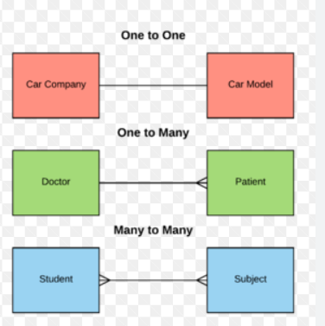
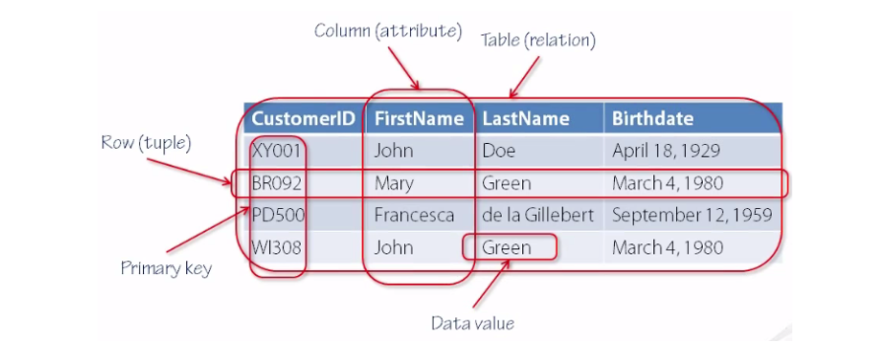
Relational Database &
Relational Database Management System(RDBMS)
In this database, every piece of information has a relationship with every other piece of information.
The data in RDBMS is stored in database objects called tables. A table is a collection of related data entries and it consists of columns and rows. Data can be accessed easily in RDBMS.
Every row of data in the database is linked with another row using a primary key. Similarly, every table is linked with another table using a foreign key.

Slide 10
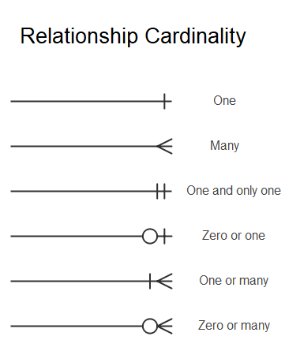

Slide 11
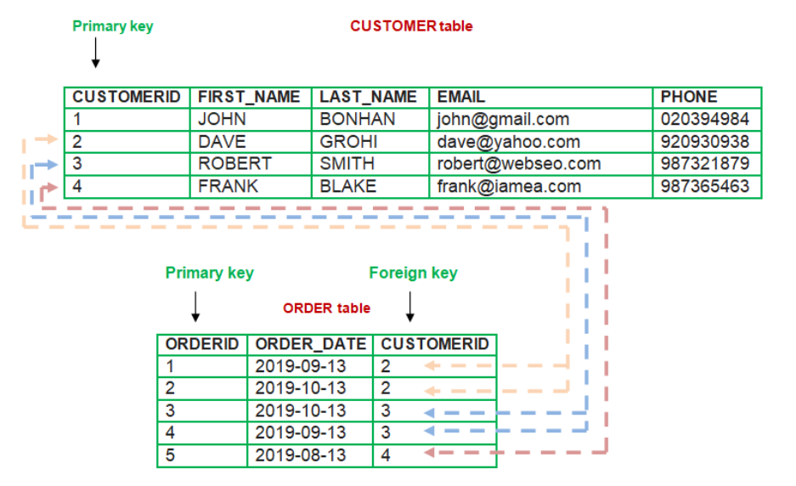
Primary Key & Foreign Key 1. A primary key is a column that uniquely identifies every row in the table of the relational database management system, while a foreign key is a column that creates a relationship between two tables. 2. The primary Key never accepts null values, whereas the foreign key may accept multiple null values. 3. You can have only a single primary key in a table, while you can have multiple foreign keys in a table. 4. The value of the primary key can’t be removed from the parent table, whereas the value of foreign key value can be removed from the child table. 5. No two rows can have any identical values for a primary key; on the other hand, a foreign key can contain duplicate values.

Slide 12
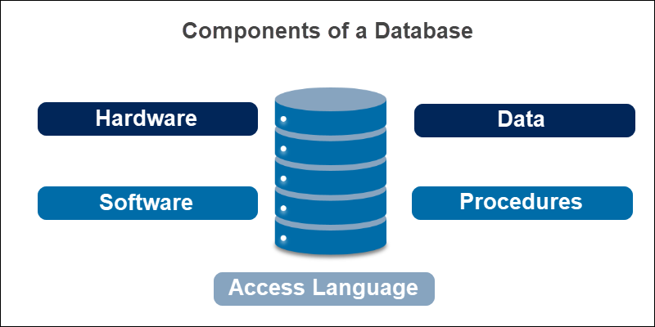
Components of Database
Databases are used for storing, maintaining and accessing any sort of data.
We normally work with client & Server while using databases.

Slide 13
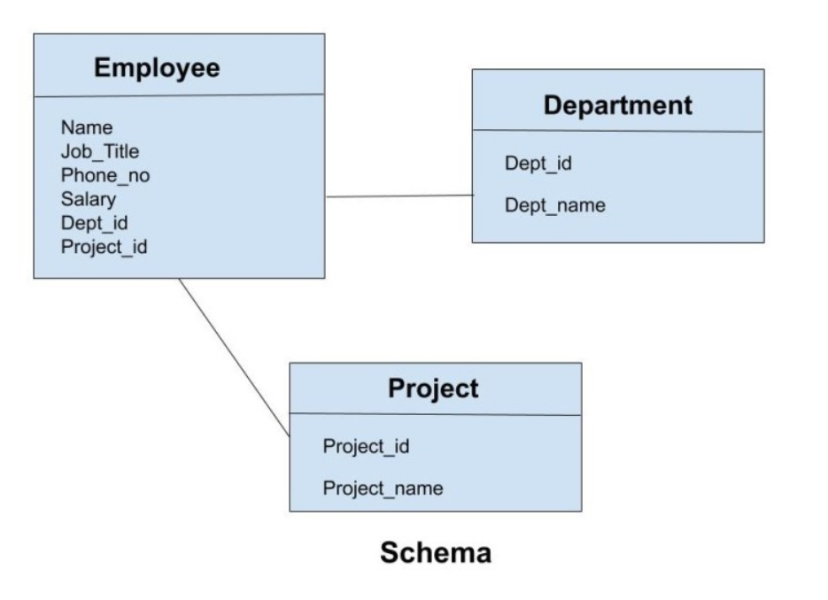
Terminologies used while working with Databases
Table
Row
Column
Null Values:
The NULL value of the table specifies that the field has been left blank during record creation. It is different from the value filled with zero or a field that contains space.
Schema: Information about database and table layout and properties

