Slide 1
•Kalimah Tayyibah
•The oneness Of Allah توحيد
•Kalimah Shahadah
•Allah , the Sustainer ٱللَّهُ ٱلصَّمَدُ
•Creation of Allah هَٰذَا خَلۡقُ ٱللَّهِ
•Creator ( al-Khaaliq ) ٱلْخَالِقُ
•AR- RAHMAAN ٱلْرَّحْمَـانُ ( The Beneficent )
•Human بشر
8- faith ( Iman ) BELIEVES إِيمَان
9- Prophet and Messenger ( nabi , نبی ) and ( rasul , رسول )
10 -Malak ( ملك ) Malaikah ( ملائكة
11-Heavenly Books الكتب السماوية 📚
12 :﷽ . is an Aayah ( verse ) of the Noble Qur'an
13-The Pillars of Islam أركان الإسلام
14-Mosque ( Masjid ) مَسْجِد

Slide 2
15-Adhan أَذَان
15- Prophet Muhammad ( صَلَّىٰ ٱللَّٰهُ عَلَيْهِ وَسَلَّمَ )
Year of Elephant عام الفيل
16- Family of Prophet Muhammad ( صَلَّىٰ ٱللَّٰهُ عَلَيْهِ وَسَلَّمَ)
Mother of Prophet Muhammad ( صَلَّىٰ ٱللَّٰهُ عَلَيْهِ وَسَلَّمَ)
17- KINDNESS OF PROPHET MOHAMMAD ( صَلَّىٰ ٱللَّٰهُ عَلَيْهِ وَسَلَّمَ)
Prophet Muhammad ( صَلَّىٰ ٱللَّٰهُ عَلَيْهِ وَسَلَّمَ ) Compassion
18- Du'aa ( دعاء )
19-Right hand اليد اليمن
20- Istinjaa ( استنجاء )
22- Muslim Bathroom Etiquette قضاء الحاجة
23-Etiquette of Eating
24- Etiquette of Drinking
25-Duaa of eating
26-Allah is All-Knowing
27-As-Sami ٱلْسَّمِيعُ

Slide 3
28-Iman( ایمان)
29-six articles of faith
30-Believe in the الله
31-believe in angels
32-Belief in the Books of الله
33-Belief in the Prophets or Messengers of الله(GOD)
34-Belief in the Day of Judgment
35-Belief in the Divine Decree
36-Islam is based on five pillars
37-Salah or prayer
38-The five daily prayers
39-Tahrah Being clean
40-Times of the Prayers
41-Number of rokahs of the five daily prayers
42-Performing salah (prayer)

Slide 4
43-Rokah
44-Ruku & Sujud
45-Sunnah salat, or صلاة السنة
46-REQUIRED (WAJIB) PRAYERS
47-FRIDAY PRAYER صَلَاة ٱلْجُمُعَة
48-Recommended payers
49-Sunnah of Friday
50-Janazah (funeral) Prayer
51-Eid prayer
52-Sunnah Eid prayer
53-Wudu الوضوء
54-Preforming Wudu الوضوء
55-Tashahhud تَشَهُّد
56-Salawat on the Prophet Muhammad صَلَوَات
57-Benefits and Why You Should Recite The Salawat صَلَوَات

Slide 5
58-Dhikr ذکر
59-Duaa After Waking Up
60-Duaa of traveling
61-Duaa of sneezing (عَطَسَ)
62-Dua before sleeping
63- Telling Lie In Islam
64-Telling the Truth
65-Stealing السرقه
66-Admit Our Mistakes
67-Etiquette of Talking
68-Smiling is charity
69-Etiquette of going out
70-Etiquette of sitting
71-Islamic calendar
72-Harms Of Tongues

Slide 6
73-Gossiping
74-Backbiting
75-The First Human
76-lblees إِبْلِيسْ
77-Prophet lbraaheem
78-How did lbraaheem(PBUH) smashed Idols
79-Isma eel(PBUH)) The Sacrificed One
80-Well of Zamzam
81-Prophet lsahaq إِسْحٰق
82-pure water gift from Allah
83-Pure and Impure
84-Tahaarah (طهارة)

Slide 7
85-Supporter of the Needy
86-Cave of Hira
87-Waraqah ibn Nawfal
88-Ali son of Abu Talib (PBUH)
89-Jafar ibn Abee Talib
90-Allah is All Knowledgeable
91-The revelation الوحي
92-Zakah زَكاة
93-Zakah on gold and silver
94-Disobedience and Punishment
95-Allahs Guidance
96-Fasting صيام
97- Kinds of Fasting
98- Ramadan رَمَضَان

Slide 8
99- Eed ul fitr عيد الفطر
100- The Eed prayer(Salaat-ui-Eed)صلاة العيد
101- Eed-ui-Adh-haa & hajj (pilgrimage)عيد الأضحى
102- Performing Hajj حج
103- Eed-ui-Adh-haa & Slaughtering animal
104- Halaal foods and drinks حلال
105- Haraam foods and drinksحَرَام
106- Greeting in Islamالسَّلاَمُ عَلَيْكُمْ وَرَحْمَةُ اللهِ وَبَرَكَاتُهُ
107- Brush your teethنظف أسنانك
108- Wash your body غسل
109-Conditions of Salah
110-obligatory parts of salah
111-Sunanh Acts Of Salah
112-Azkar After Prayer أذكار بعد الصلاة المفروضة
113-10 SAYS OF PROPHET (PBUH)

Slide 9
114-Zayd ibn Haarithah
115-Umm Ayman أمّ أيمن
116-Tawheed key into Paradise
117-Allah is extremely power full
118-The mercy of Allah
119-Prophets message
120-Death and Life
121-The Life After Death
132-Prophet Ayyub أيوب ( عَلَيْهِ ٱلسَّلَامُ )
133-Prophet Ilyaas ( ٱلسَّلَامُ ) إلياس
134- The story of Yunus ( ٱلسَّلَامُ ) يُونُس
135- Time Value قيمة الوقت
136- Ammar & Yaasir ( رَضِی اللہُ عَنھُما ) عمار ابن ياسر
137- Safiyyah Bint Abd ai-Muttalibصفية بنت عبدالمطلب

Slide 10
138- Ruqayyah daughter of the Prophet ( PBUH ) رقيّة
139- Parents Right حق الوالدين
140- The Quran Rights حُقُوقْ القُرآنُ الكَريمُ
141- Fingerprint the unique creation of Allah بَلٰى قٰدِرِيْنَ عَلٰٓي اَنْ نُّسَوِّيَ بَنَانَهٗ
142- purposes of dressing & clothes
143- Good moral character وإنك لعلى خلق عظيم
144- Prophet Muhammad ( SAAW ) as the Best Role Model of Humanity لَقَدۡ كَانَ لَكُمۡ فِىۡ رَسُوۡلِ اللّٰهِ اُسۡوَةٌ حَسَنَةٌ
145- Friend relationships علاقات الأصدقاء147- Animals Rights in Islam
148- 7Good Habits of Muslims
149- Being thankful لَئِن شَكَرۡتُمۡ لَأَزِيدَنَّكُمۡۖ
150- favours of Allah فَبِأَىِّ ءَالَآءِ رَبِّكُمَا تُكَذِّبَانِ
152- Etiquette of Conversation آداب المحادثة

Slide 11
154- Prophet Nuh ( عَلَيْهِ ٱلسَّلَامُ ) نُوحٌ
156- Prophet Hud هُودٌ (عَلَيْهِ ٱلسَّلَامُ
157- Prophet Saleh (عَلَيْهِ ٱلسَّلَامُ) صَالِحٌ
159- Khadijah bint Khuwaylid خَدِيجَةُ بِنْتُ خُوَيْلٍدٍ
160- Abu Dharr al-Ghifaaree أَبُو ذَرّ ٱلْغِفَارِيّ ٱلْكِنَانِيّ
161- Abu Ubaidah ibn ai-Jarraah أبو عبيدة بن الجراح
162- Bilal ibn Rabaah بِلَال بِن رَبَاح
164- Talhah ibn Ubaidillah طَلْحَة بن عُبَيْد اللّه التَّيمي
165- Umm Sulaym is الرميصاء بنت ملحان
167- Islam and Science علوم و الدين
168- Mathematics and Muslims
169- Medicine And Muslims
170-Rasool and Nabee رسول و نبي
171-The Seal of Prophetsخاتم النبيين

Slide 12
176- Isha daughter of ( Abu Bokr os-Siddeeq ) عائشة بنت أبوبکر
177- Family life of Prophet Muhammad ﷺ
178- Hijrah (The Emigration)هجرة
181- Patience الصبر
183- Tayammum تيمم
184- Qasr prayers:( Shortening the Prayers) صَلاةُ القَصر ,صَلاةُ المُسافِر
186- Prophet Musa ( عَلَيْهِ ٱلسَّلَامُ ) موسى
188- Salmaan al-Faarisee ( PBUH )سَلْمَان ٱلْفَارِسِيّ
189- prostration of recitation ( tilawa ) سجود التلاوة
190- Dangerous of - Drinks and Drugs المشروبات والمخدرات

Slide 32
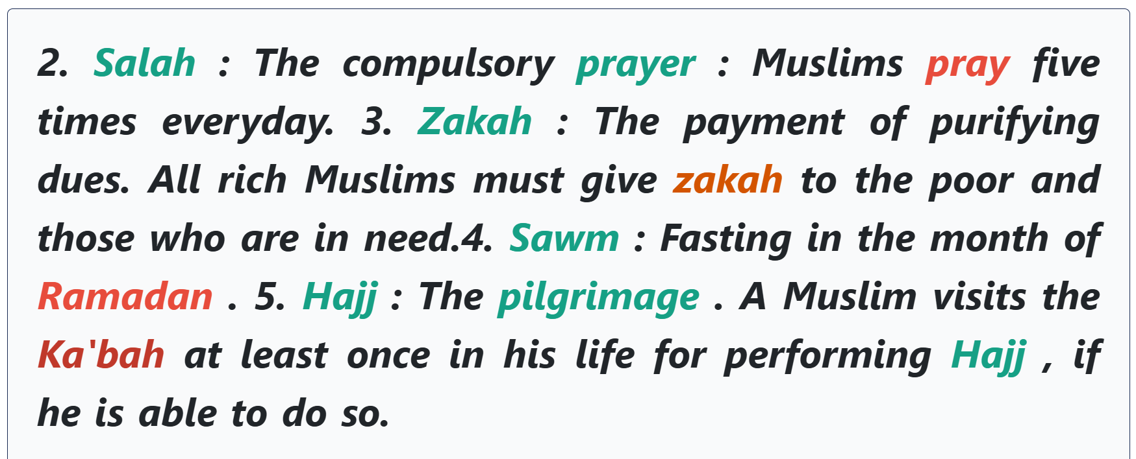

Slide 35
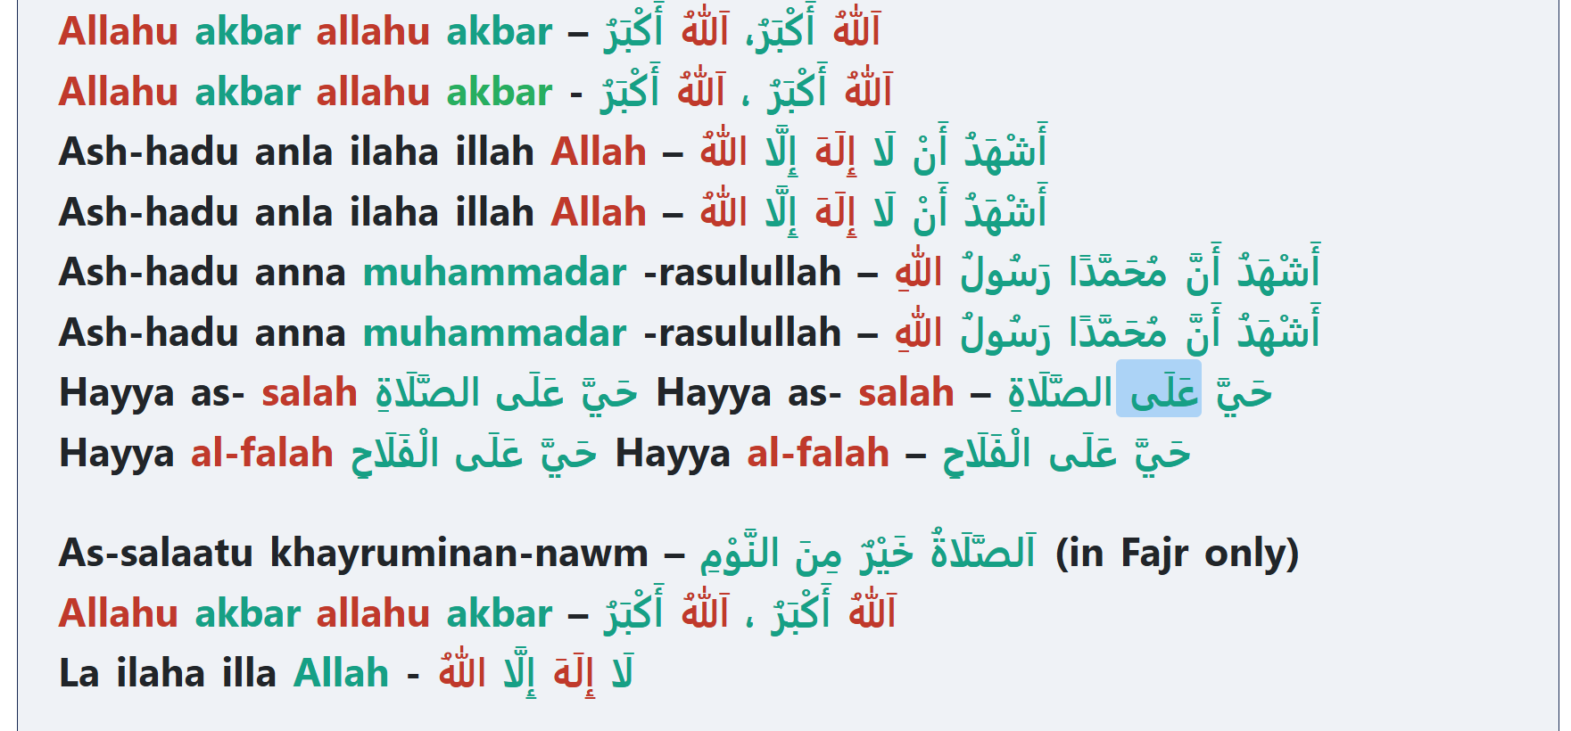

Slide 40
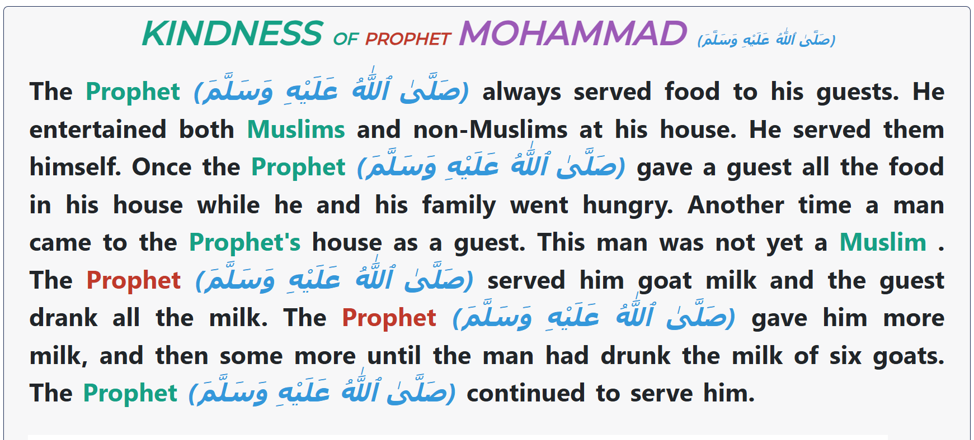

Slide 68
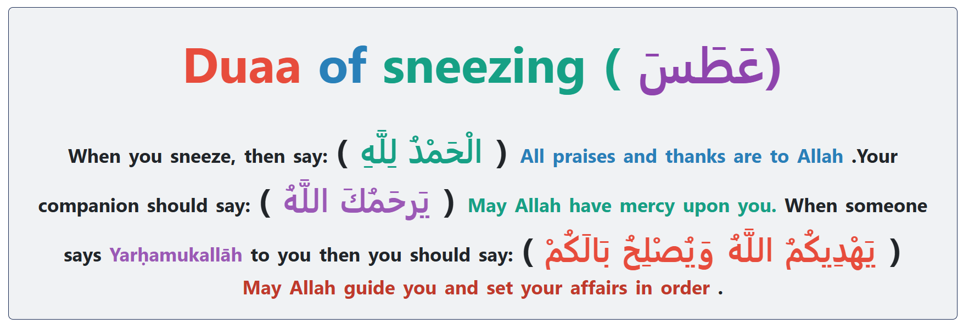

Slide 114
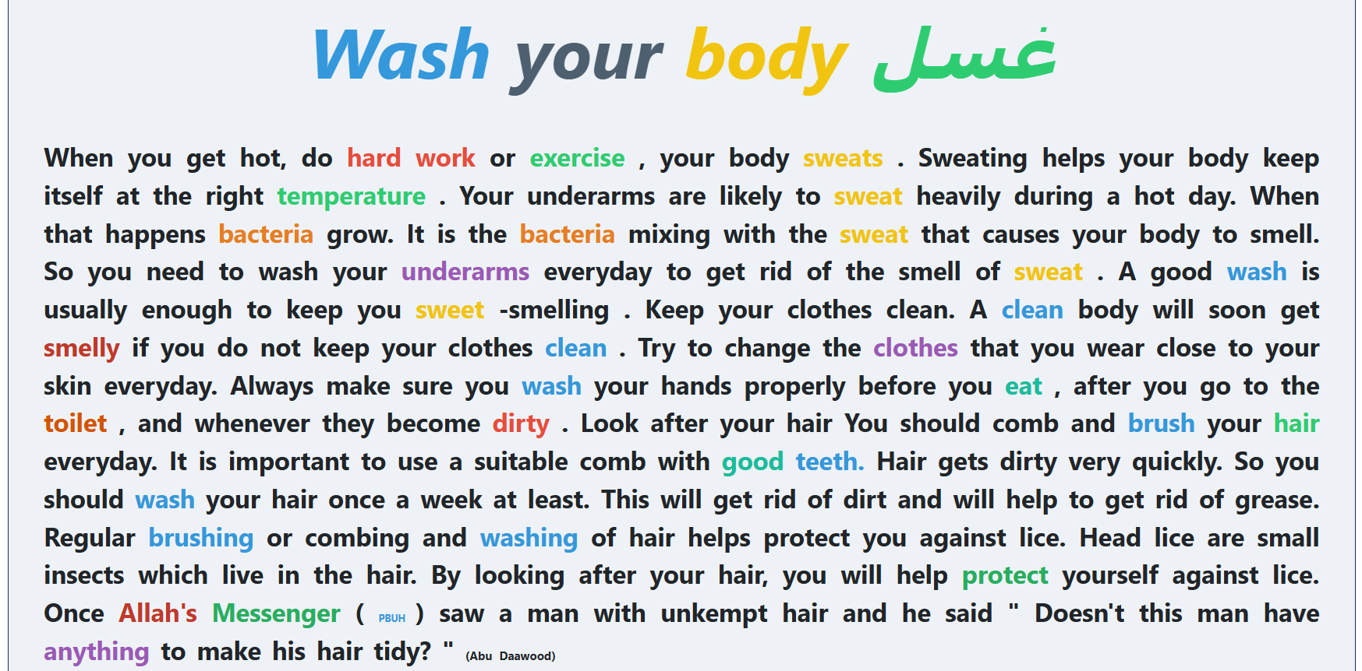

Slide 116
